Slide 1
Sustainability – Energy & More
EAS 3110
January 2015
Office of Campus Sustainability

Slide 2
Objectives for Today
Provide context for sustainability @ GT
Share updates
  Campus sustainability – approach and initiatives
  Energy usage and conservation
Discuss!

Slide 3
Presenters
Office of Campus Sustainability
  Anne Rogers
  JulieAnne Williamson
Office of Facilities Management
  Michael Leasure

Slide 4
Sustainability @ GT
Includes Education, Research, Practice
Definition from QEP:
  Sustainability is “transforming our ways of living to maximize the chances that environmental and social conditions will indefinitely support human security, wellbeing, and health.”
  McMichael, Butler & Folke, 2003

Slide 5
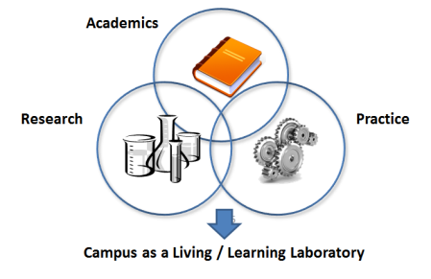
Holistic Approach
It requires partnership between academics, research, and practice to create the environment for success.

Slide 6
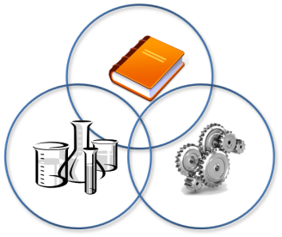
Office of Campus Sustainability
Our role: to help coordinate the agenda for “Practice”, and relationships with Academic, Community (student, faculty, staff, visitor), and Research partners.
Community
Academics
Research
Practice

Slide 7
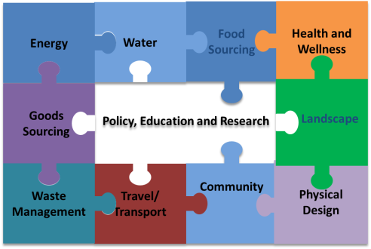
More than “Being Green”
There are so many aspects of sustainability, each with multiple programs and goals…

Slide 8
Academics and Research
Over 200 sustainability-focused courses
spanning every college
Goal: every student will take at least one
sustainability-focused course
Strategic Goal: to graduate good global
citizens

Slide 9
Putting Concepts into Practice
Starts with integrated planning
  Georgia Tech Strategic Plan, Campus Master Plan
Requires shared goals and real measures
  ACUPCC Climate Action Plan
Infuses planning and operations at all levels
  Landscape Master Plan, Tree Campus USA
  Stormwater Master Plan
  … and more!

Slide 10
Goals
Strategic
  Enhance living, working and learning environment
  Utilize the campus as a living, learning laboratory for student and faculty
Measurable and Actionable
  Reduce energy use to 50% below 2007 levels, by 2040
  Expand renewable energy use to 10% of energy consumed on campus by 2040
  Be carbon neutral by 2050
  Increase tree canopy by replacing aging trees
  Increase water capture and reuse
  Reduce water consumption
  Reduce stormwater runoff by 50%

Slide 11
Measures
American College and University Presidents’ Climate Commitment (ACUPCC)
Sustainability Tracking Assessment and Rating System (STARS)
Leadership in Energy and Environmental Design (LEED)
Greenhouse Gas Inventory
APPA National Survey

Slide 12
Broad Spectrum of Activities
Recycling
Waste avoidance
Composting
Locally sourcing food
Smart procurement
Campus transportation
Bicycle-friendliness
Earth Day
Tech Beautification Day
Cisterns
Landscape management
Tree canopy development
Energy development (photovoltaic, geothermal)
Energy conservation
Energy revolving fund
Research and modeling of infrastructure
Smart metering
Smart lighting
Stormwater management planning
Responsible building design
…. And more!

Slide 13
Quick Facts
Energy – 623 kW of photovoltaic energy development
Landscaping – nearly 12,000 trees over 400+ acres in an urban environment
Water –
  2.25 million gallons of storage for stormwater management
  Trayless dining reduces water use by 31,500 gal / wk
  92% of toilets use 1.6GPM or less
Food Sourcing – over 35% of produce purchases considered local
  Local farmers market regularly held on campus
Community –
  In 3 shifts, Campus Kitchen turned leftovers into 500 meals for local shelters / food banks
  Student Center Herb Garden yield used by Dining Services
Physical Design – 125 sq. ft. of LEED space / student
  Nearly 500k gsf at Platinum, 1.7M at Gold, and 325K at Silver
  LEED Certified Master Site
Travel / Transport – 35% of campus commuters use alternative transportation options
  130 are permitted electric vehicle (EV) drivers, with 33 charging stations
Waste Management –
  965 tons of waste diversion in 2013
  Game Day Recycling Program diverted 120 tons from landfill and involved more than 1,000 volunteers from inception in 2008 to 9/30/14
  In 6 months, Dining Services diverted 78 tons of compost from the landfill

Slide 14
Where We Are & Where We Are Going
Intentional, cohesive portfolio of sustainable activities
Aligned with sustainability master plan
Resourced appropriately
Measured and communicated
Shared governance
Integration with curriculum and research – living laboratory
Serve.Learn.Sustain. (QEP)
“Random Acts of Green”
Many good activities
Collaboration is relationship-dependent and opportunistic
Opportunities for shared overarching goals and leverageable, aligned data

Slide 15
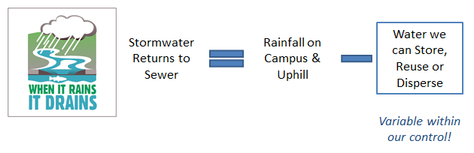
Example: Stormwater Goals
2004 Campus Master Plan:
  Return campus to 1950 stormwater levels
  ~50% reduction to 2004 levels
Changing the equation:

Slide 16
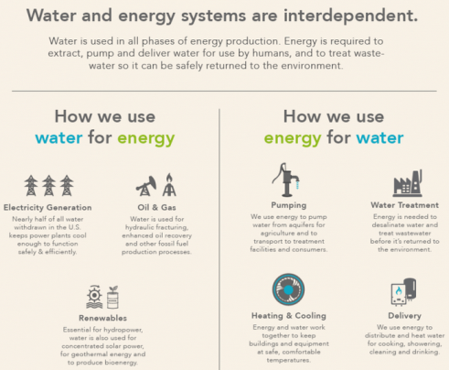
The Water-Energy Nexus
Source: Department of Energy http://energy.gov/articles/ensuring-resiliency-our-future-water-and-energy-systems

Slide 17
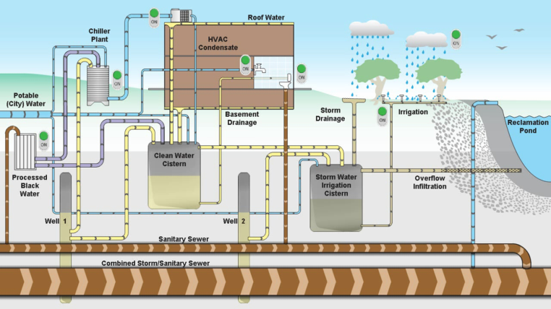
Stormwater Master Plan: Flow Diagram
Source: Capital Planning & Space Management, Jason Gregory
Stormwater Master Plan: http://www.space.gatech.edu/landscapeplan/assets/StormwaterMasterPlan-BasinA.pdf

Slide 18
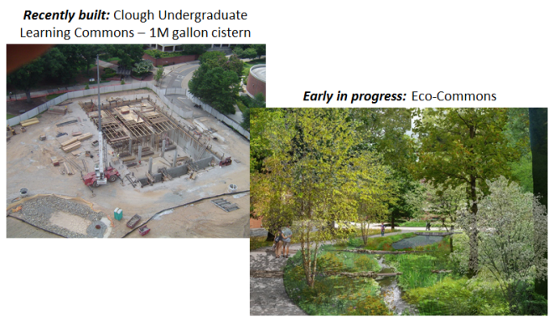
Elements

Slide 19
Achieving Results
Multi-year, multi-project approach
Have 2.25 million gallons of stormwater storage capacity – and counting
Non-potable water use in CULC
  Toilet flushing
  Irrigation

Slide 20
Questions?

Slide 21
Energy: What is Happening @ GT
Mike Leasure

Slide 22
Notes from Kim on Content
Do we have data on campus electricity consumption through time?
What types of energy sources fuel the electricity from GP, % natural gas, % these trending in recent years?
What's the difference in energy consumption between a LEEDS-certified building (Klaus?) vs a non-LEEDS building?

