Slide 1
Environmental Impacts of Transportation
Spring 2015
Dr. Michael Rodgers, Deputy Director
National Center for Transportation Systems Productivity and Management
&
School of Civil and Environmental Engineering
Georgia Institute of Technology

Slide 2
Environmental Impacts
Impacts in all elements of transportation
  Vehicle Cycle
  Fuel Cycle
  Infrastructure Cycle
Both direct and indirect impacts
  Direct
    Directly associated with construction or usage of transportation
  Indirect
    Impacts on the operation or structure of other natural and built systems

Slide 3
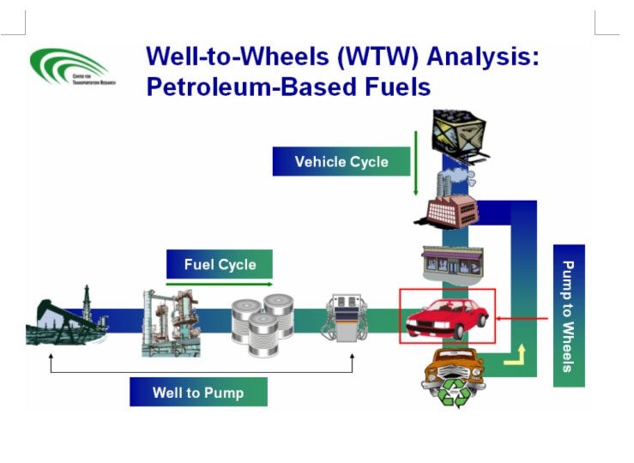
Fuel and Vehicle Cycles
Argonne National Laboratory GREET Model

Slide 4
Direct Impacts
Atmosphere
  Emissions of toxics and criteria pollutants
Hydrosphere
  Drainage and Flooding
  Runoff
Geosphere
  Consumptive land use
  Erosion
Biosphere
  Wildlife impacts
  Exotic and invasive species

Slide 5
Indirect Impacts
Atmosphere
  Emissions of Radiatively Important Trace Substances (RITS)… Climatic Impacts
  Weather modification
Hydrosphere
  Oceanic Pollution
Geosphere
  Impacts on Geomorphology
Biosphere
  Habitat Impacts
  Clearing and mowing

Slide 6
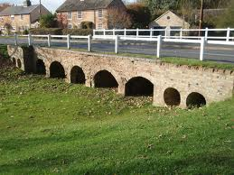
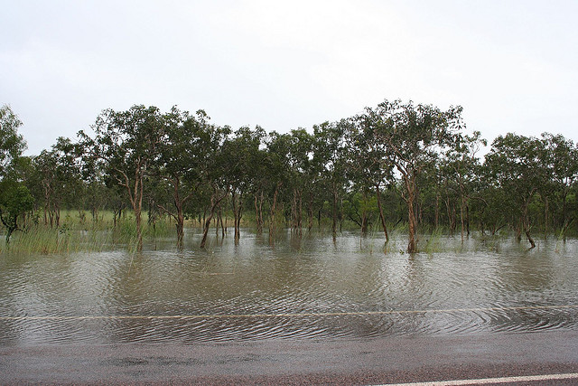
Impacts on Drainage
Reduction of overland flow relative to channelized flow
Impacts of damming due to raised roadbeds
Increase in impervious surface associated with transportation infrastructure
Commons.wikipedia
Florida DOT

Slide 7
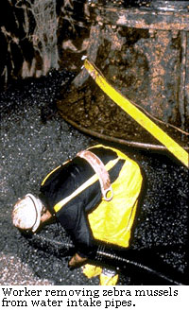
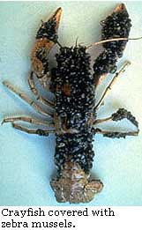
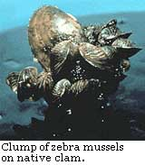
Zebra Mussels
Dreissena polymorpha
Native to Russia
Introduced through ballast water in the early 1980’s
Can colonize virtually any substrate
R. Peplowski, Detroit Edison
Nationalatlas.gov

Slide 8
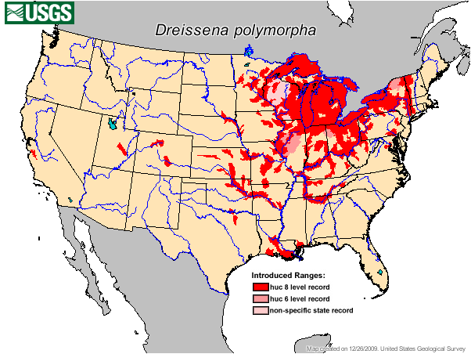
Zebra Mussel Distribution

Slide 9
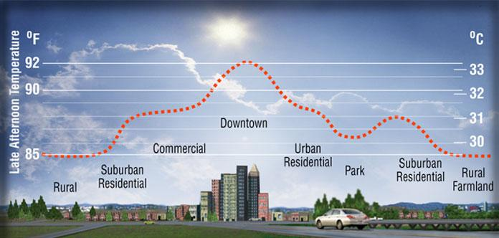
Urban Heat Island
Heatisland.lbl.gov
The built environment typically has lower albedo than vegetated surfaces
Transportation infrastructure and rooftops are the most important contributors

Slide 10
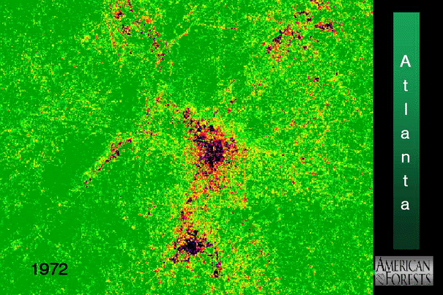
Atlanta Heat Island

Slide 11
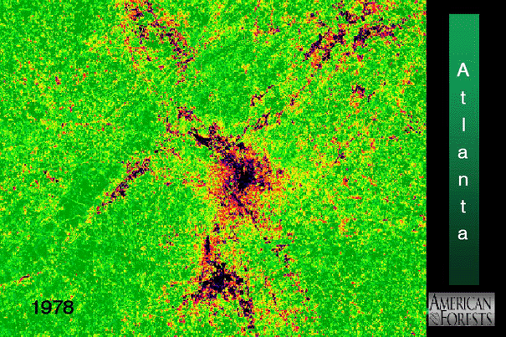
Atlanta Heat Island

Slide 12
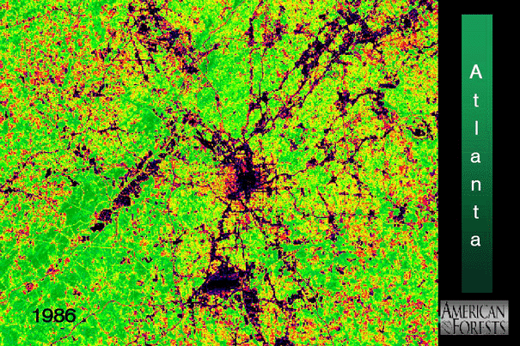
Atlanta Heat Island

Slide 13
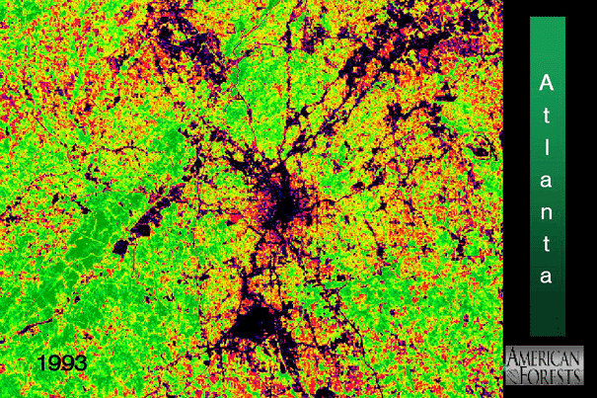
Atlanta Heat Island

Slide 14
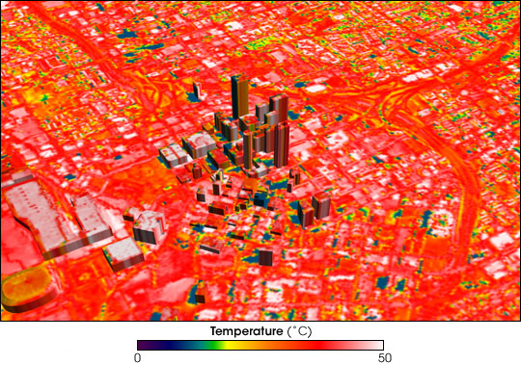
Atlanta Downtown Thermal Image
Nasa.gov

Slide 15
Common Pollutants
Ozone (NAAQS and NSPS)
  VOC
  Nitrogen Oxides
Sulfur Dioxide
Carbon Monoxide
Particulate Matter
  Total Suspended Particulates
  PM10
  PM2.5
Nitrogen Dioxide
Lead
HAPS (NESHAP)

Slide 16
Types of Pollutants
Primary Pollutants
  Emitted into the Atmosphere
  Always diminish in concentration with distance from the source
  Examples: lead, HAPS
Secondary Pollutants
  Formed within the Atmosphere
  Normally reach maximum concentration at some distance from the source
  Examples: ozone, pm

Slide 17
Mobile Emissions
On Road
  Passenger Vehicles
    Cars
    Vans
    Light Duty Trucks and SUVs
  Medium and Heavy Duty Trucks
  Motorcycles
Non-Road

Slide 18
Mobile Emissions
On Road
Non-Road
  Marine Vessels
    Inland Marine
    Maritime Vessels
  Locomotives
  Aircraft
  Off-Road Vehicles
    Agricultural
    Lawn and Garden
    Construction
    Recreation Equipment (e.g. ATV, snowmobiles, dirt bikes, etc.)
  Industrial (e.g. forklifts, generators, compressors, etc.)

Slide 19
Types of Mobile Emissions
Direct
  Combustion Exhaust
  Evaporative
    Diurnal
    Running Losses
  Refueling
Indirect
  Thermal
  Wear

Slide 20
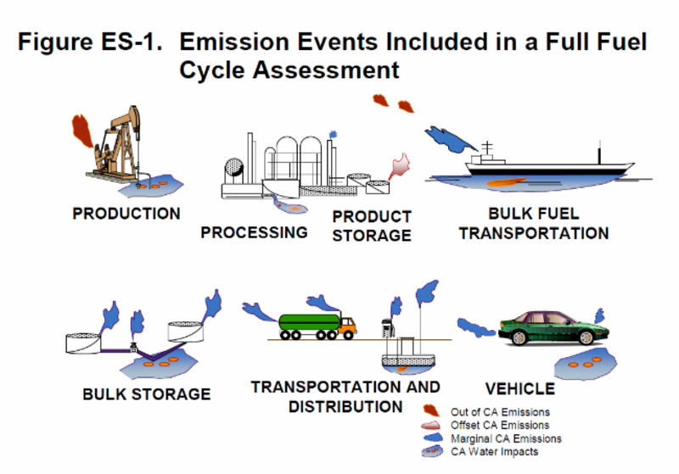
Full Cycle Emissions
Psehealthyenergy.org

Slide 21
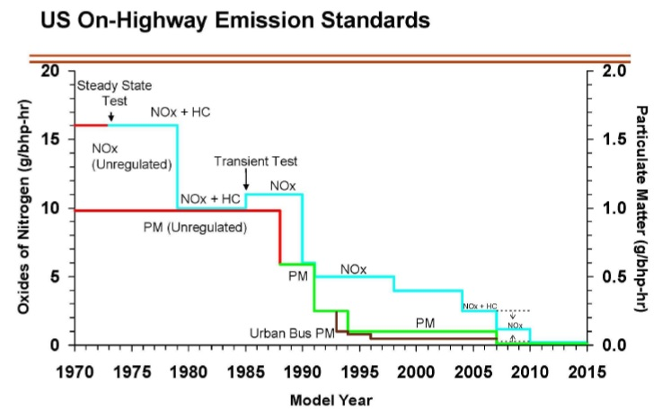

Slide 22
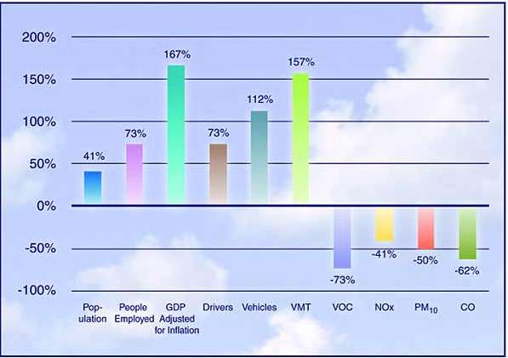
Criteria Emissions
Fhwa.dot.gov

Slide 23
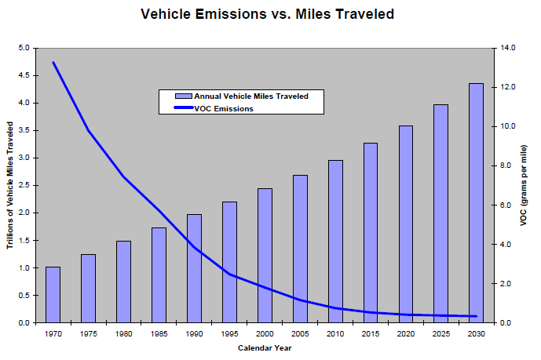
Criteria Emissions
Epa.gov

Slide 24
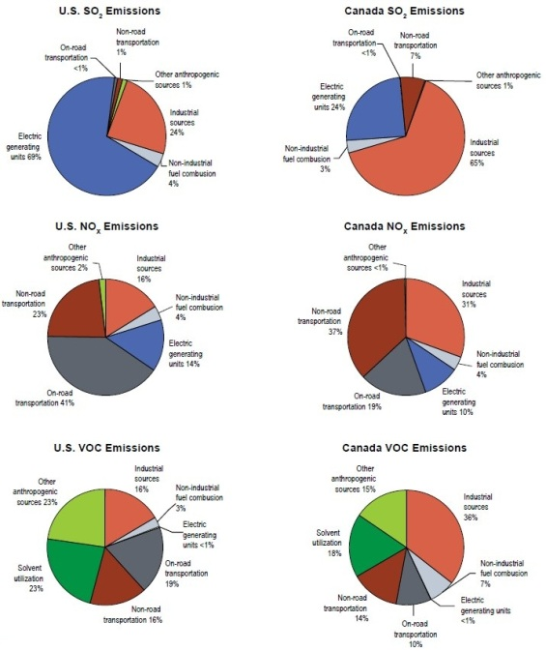
North American Criteria Pollutant Emissions
(2012)
EPA and Environment Canada

Slide 25
HAPS Emissions
Half from Mobile Sources
  27% on road
  23% non-road
Major Sources Account for 9%
Area Sources Account for 41%

Slide 26
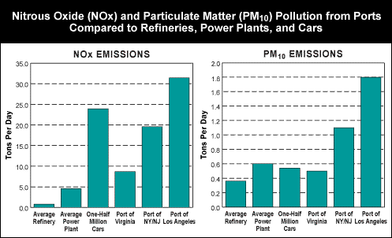
Port Emissions
Nrdc.org

Slide 27
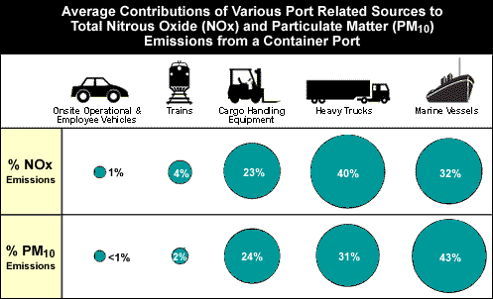
Criteria Pollutants
Nrdc.org

Slide 28
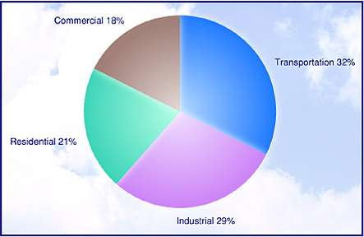
Greenhouse Gas Emissions by Sector
Fhwa.dot.gov

Slide 29
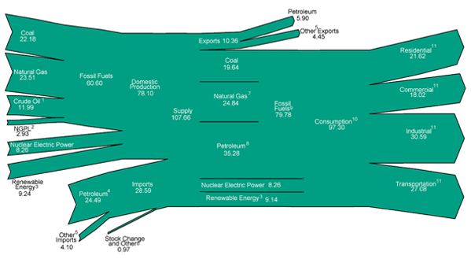
U.S. Energy Flow 2012

Slide 30
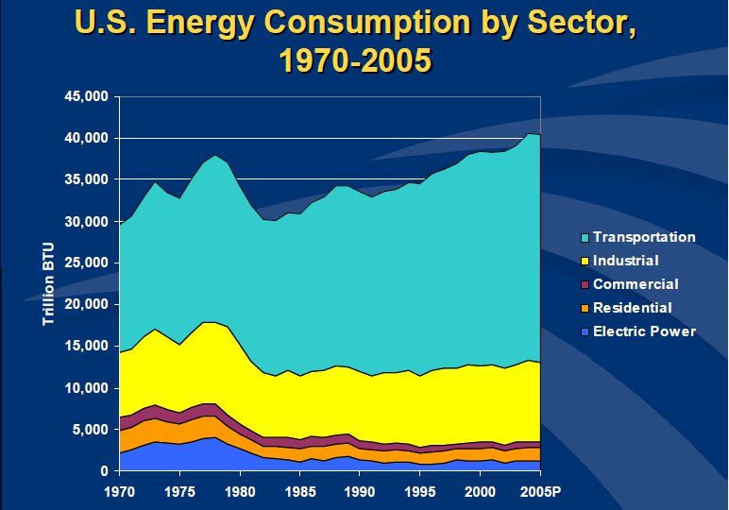
Intellectualtakeout.org

Slide 31
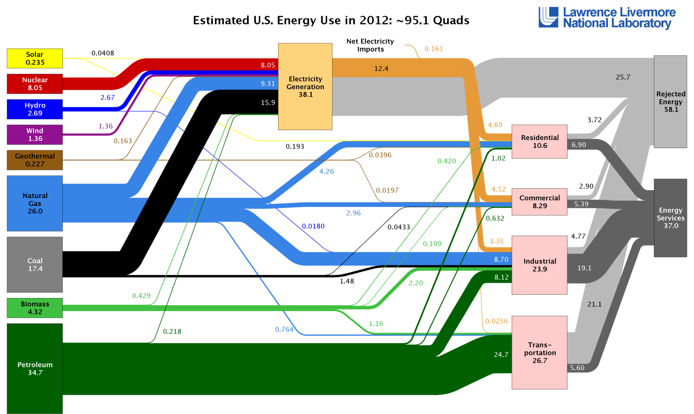
Energy Consumption

Slide 32
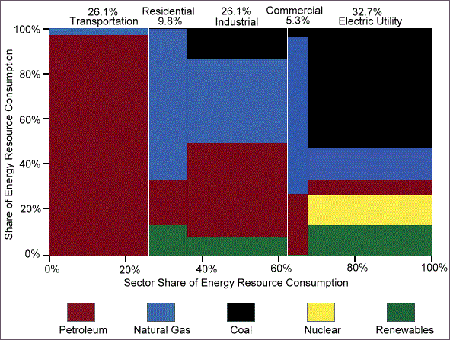
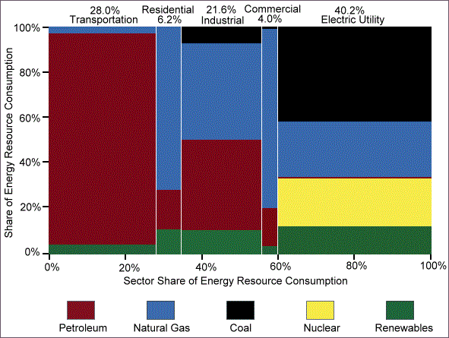
Energy Consumption by Sector and Source (EERE)
1982 73.1 quads
2012 95.1 quads

Slide 33
Transportation and Energy
Transportation is about Movement
  People
  Goods
  Services
To Initiate and Maintain Movement Requires Energy Inputs
  Replace Losses to Maintain Momentum
    Dissipative Losses (e.g. Friction, Aerodynamic Resistance, etc.)
    Gravitational Potential Energy
  Any Required Accelerations
Energy Supplied Through
  Tractive Power
  Thrust

Slide 34
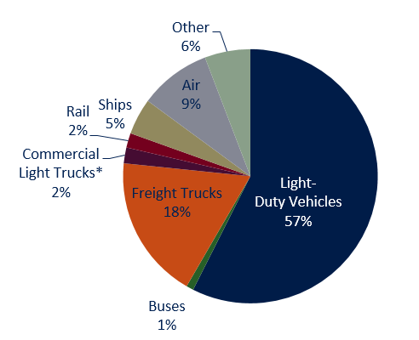
U.S. Transportation Energy Consumption by Mode (2011)
C2es.org

Slide 35
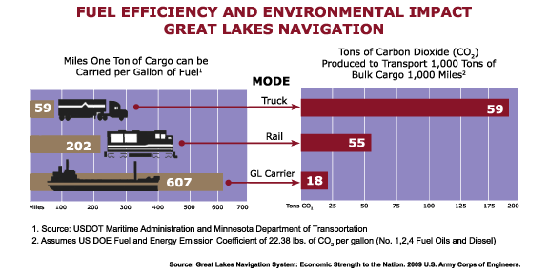
Modal Efficiency Comparison

Slide 36
Mechanical Work
Mechanical Work is a Form of Energy
  Mass Dependent
  Path Dependent
  Distance Dependent
  Speed Dependent (Resistive Loads are a Function of Speed)
Design of Transportation Systems
  Average Power Demands
    Required Load
    Power Losses
  Peak Power Demand
    Speed/Acceleration
    Overcoming Grades/Surface Resistance
  Fuel Storage/Range

Slide 37
Tractive Power Requirements
(Engine Tractive Power) = (Mass) x
[ (acceleration) + (aerodynamic load) + (grade load) + (rolling resistance) + (auxiliary loads) + (drive train losses)]
(Engine Tractive Power) = (Fuel Consumption) x (Energy Density of Fuel) x (Thermal Efficiency of Engine)

Slide 38
Carbon Dioxide Emissions
(Direct CO2 Emissions) = (Fuel Consumption) x (Carbon Content of Fuel) x (44/12)

Slide 39
Total CO2 Emissions
(Total CO2 Emissions) =
(Direct Emissions) +
(Indirect Fuel Cycle Emissions) + (Vehicle Cycle Emissions) + (Infrastructure Cycle Emissions) +
(Net Impact on Other Systems)

Slide 40
How Do We Reduce Transportation CO2 Emissions?
Reduce Direct Emissions
  Engine Technologies
    Improve Thermal Efficiency of Engine
    Alternative Fuels with Lower Carbon Content
  Vehicle Technologies
    Improve Drive Train Efficiencies
    Improve Aerodynamics
    Reduce Rolling Resistance
    Energy Recovery/Hybrid Drivetrains
    Lighten Vehicle
  Reduce Travel Demand
    Reduce Mileage
    Reduce Total Tonnage (e.g. Packaging)
    Modal Shifts

Slide 41
How Do We Reduce Transportation CO2 Emissions?
Reduce Indirect Emissions
  Improve Recyclability
    Infrastructure
    Vehicles
  Extend Lifetime
    Infrastructure
    Vehicles
    Goods
  Design/Construction of Low Impact Infrastructure

Slide 42
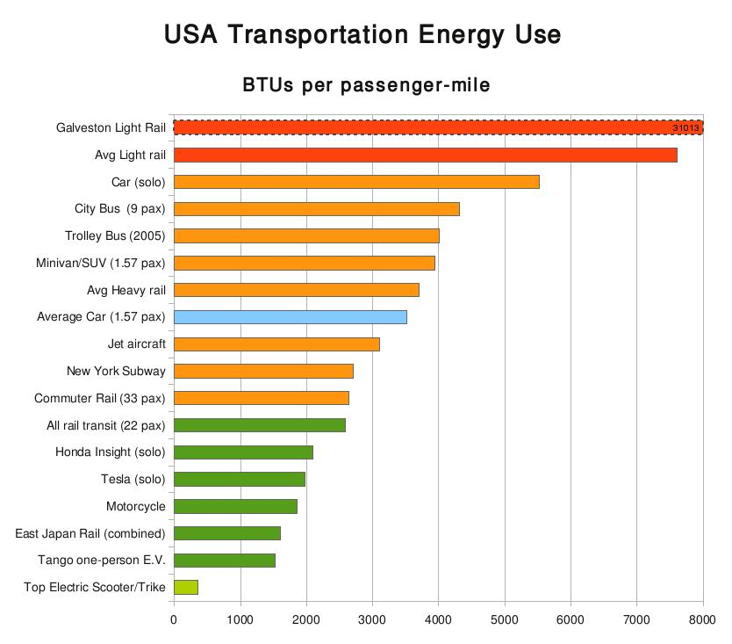
Passenger Energy Efficiency
Templetons.com

Slide 43
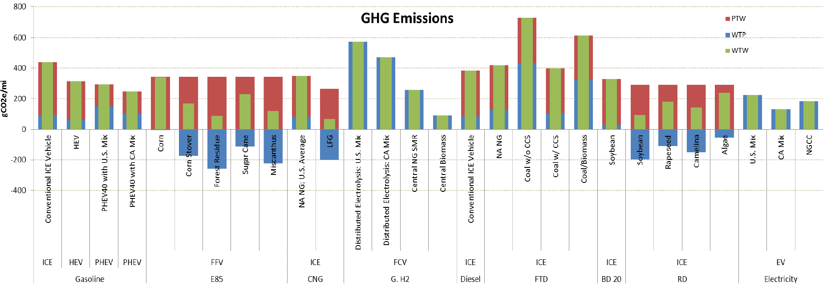
Comparison of Fuel Technologies
Argonne National Labs

