Slide 1
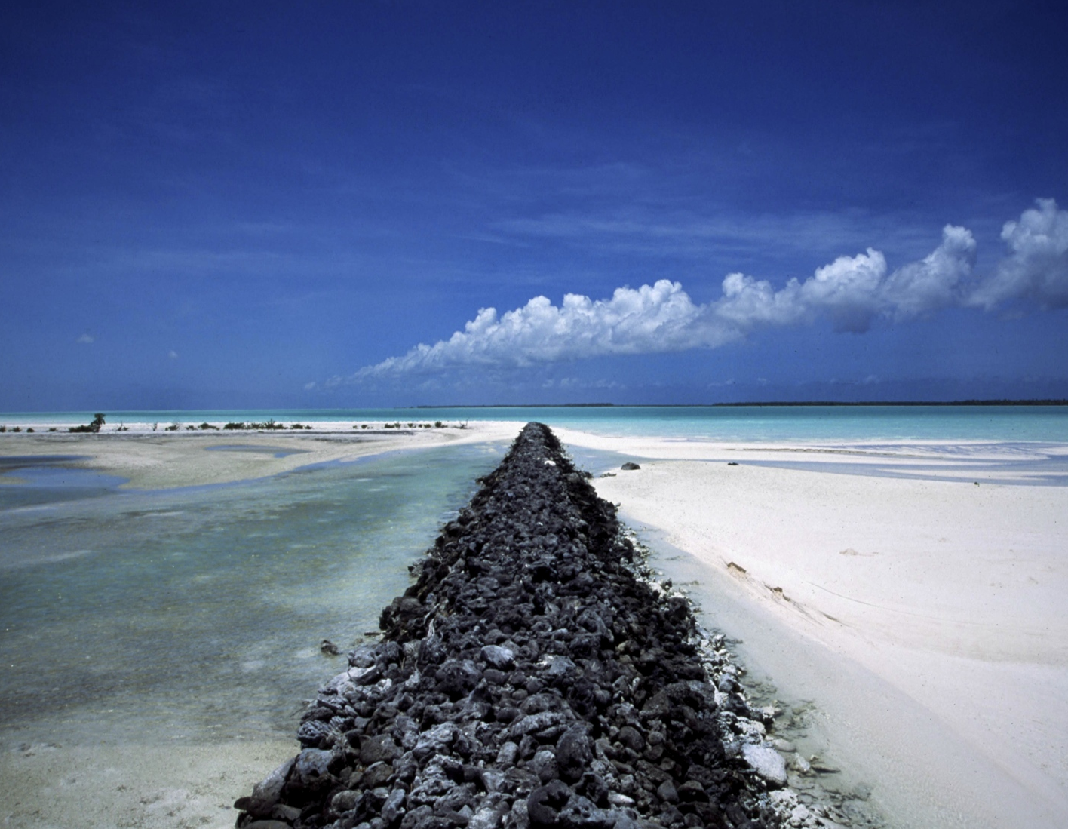
IF ROCKS
COULD
TALK
Notes:
Alternative 1st slide
THEY TALK TO ME!

Slide 2
PALEOCLIMATOLOGY

Slide 3
How do you get to be a
PALEOCLIMATOLOGIST?

Slide 4
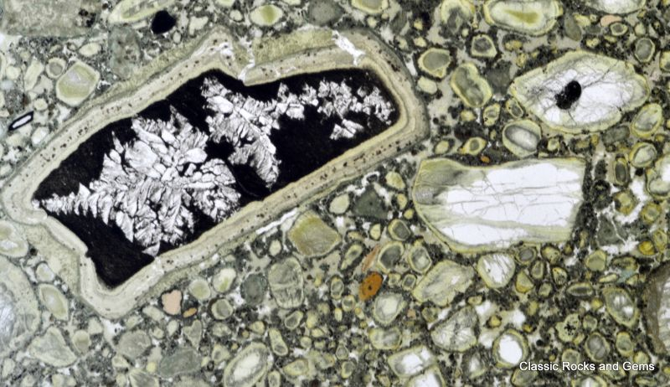
Notes:
Kimberlite thin section – this image tells a story of the rock’s history [trying to get higher res image]
Begin with story of how I fell in love with rocks/got interested in geology

Slide 5
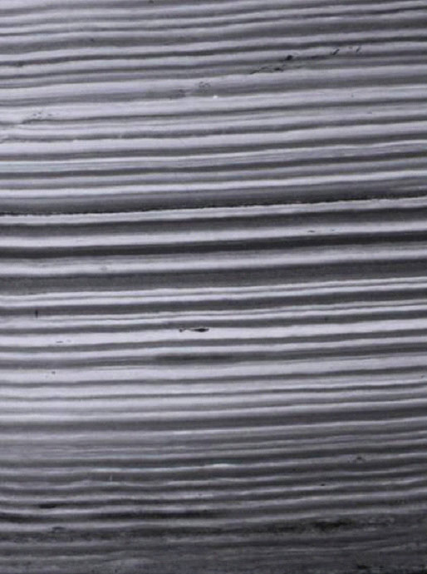
TWIST
OF FATE
Notes:
talk about how I was supposed to go to medical school, but learned of climate change in college (when I took enough art history courses to earn a minor);
winded up studying varves (photo above) at Scripps

Slide 6
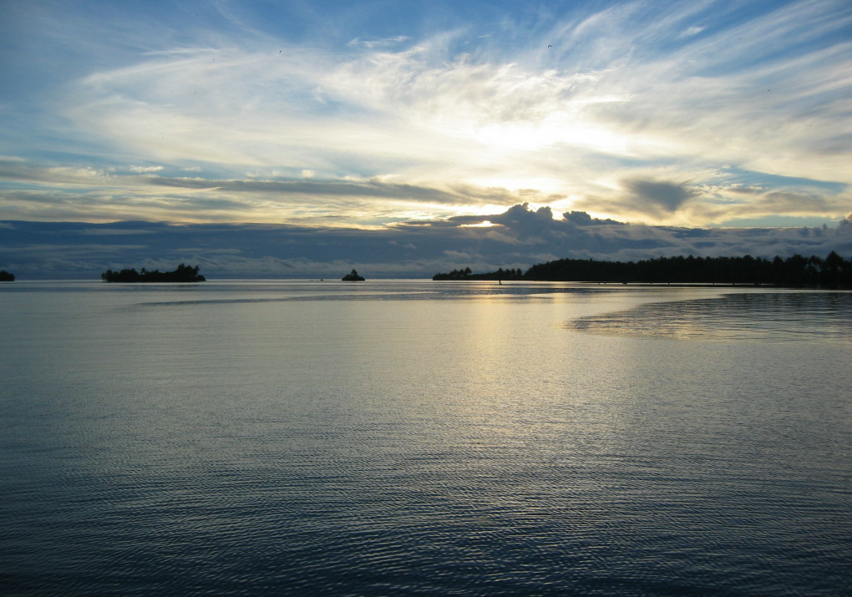

Slide 7
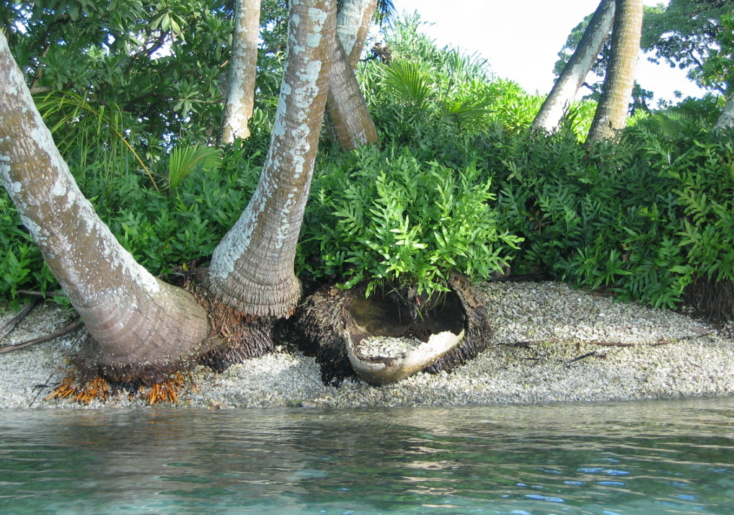
Notes:
Don’t know if these images are high-res enough – it’s all I have.

Slide 8
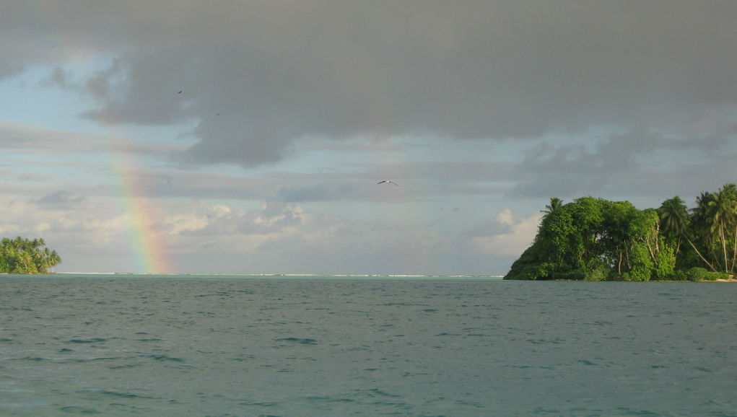

Slide 9
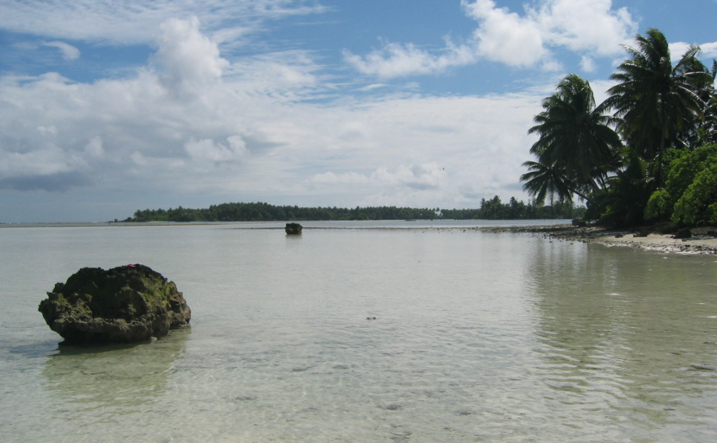

Slide 10
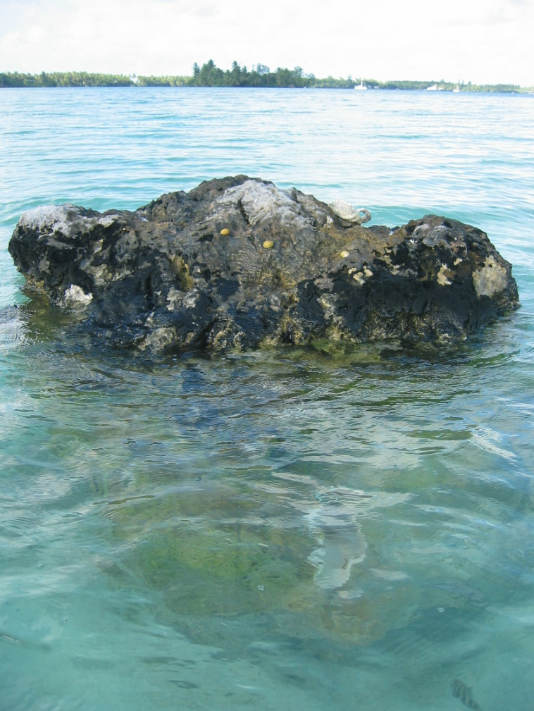
MY
MUSE

Slide 11
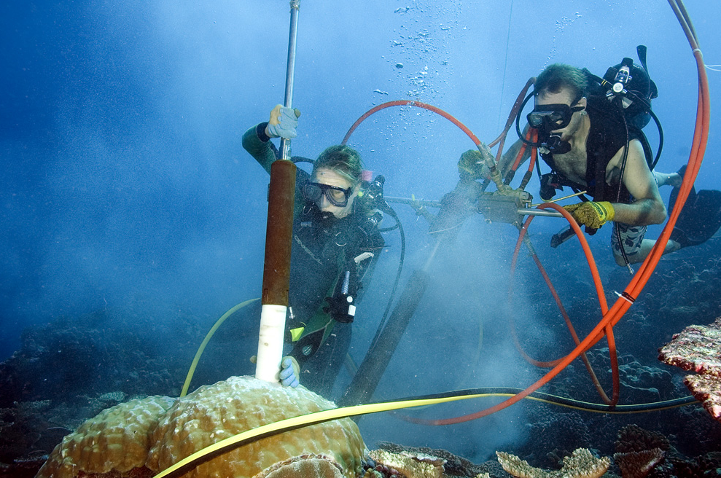
THE ULTIMATE
SOUVENIR

Slide 12
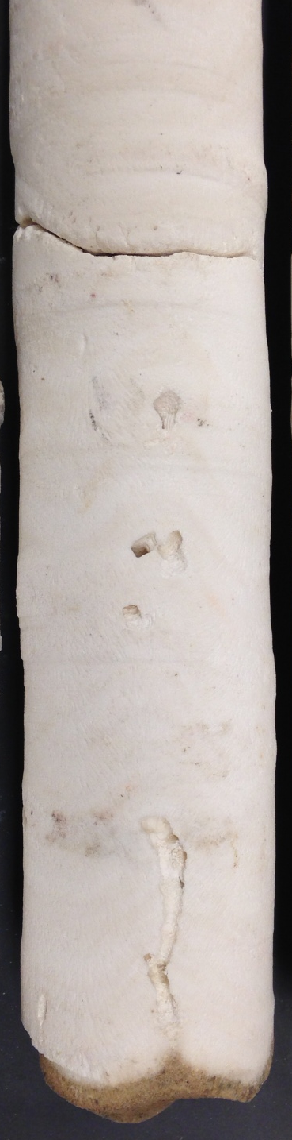
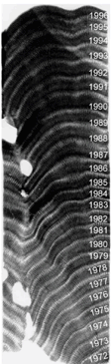
Corals as eyewitnesses
TO CLIMATE
CHANGE

Slide 13
100
YEARS

Slide 14
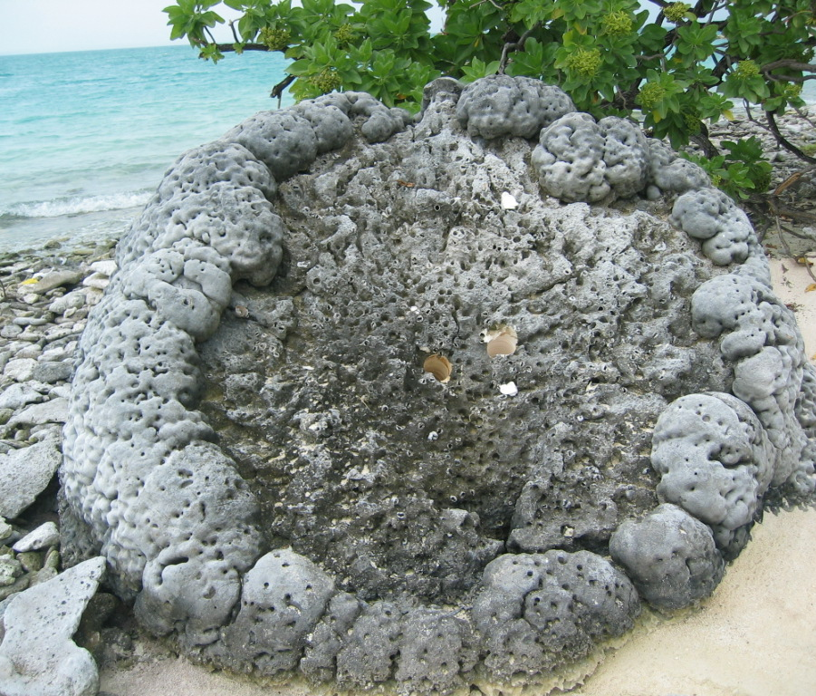
500
YEARS

Slide 15
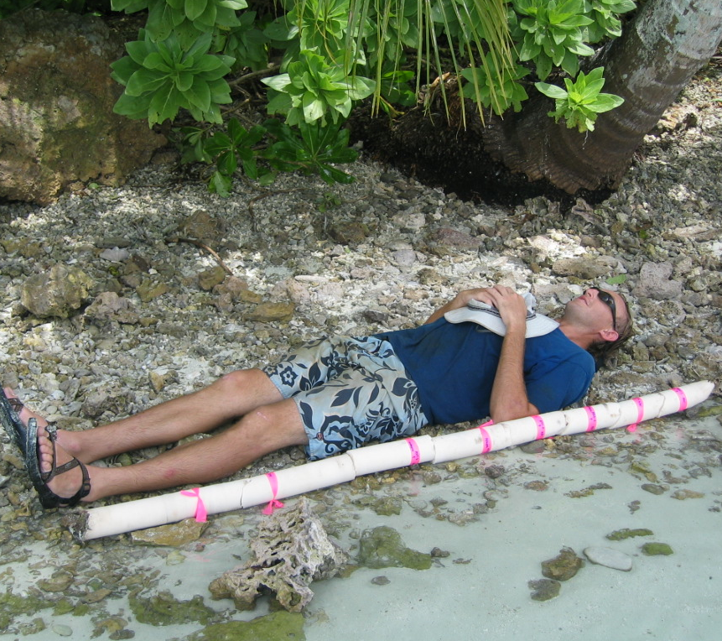
1319-1410 AD

Slide 16
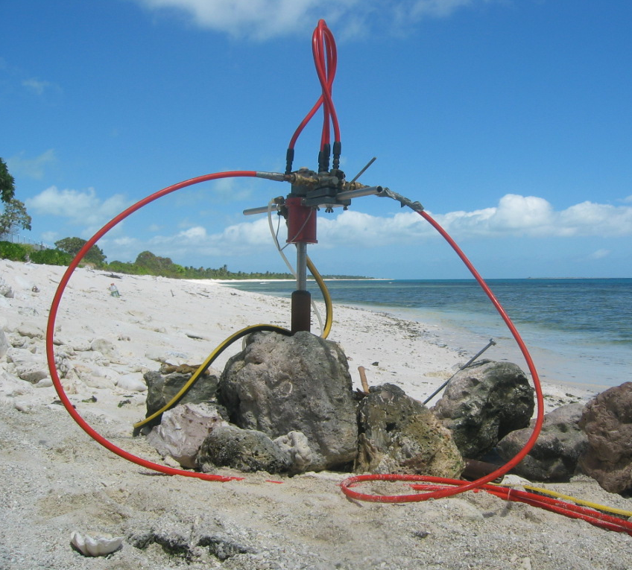
7000
YEARS

Slide 17
What do the rocks say?
FIRST WE MUST LEARN
THEIR LANGUAGE.

Slide 18
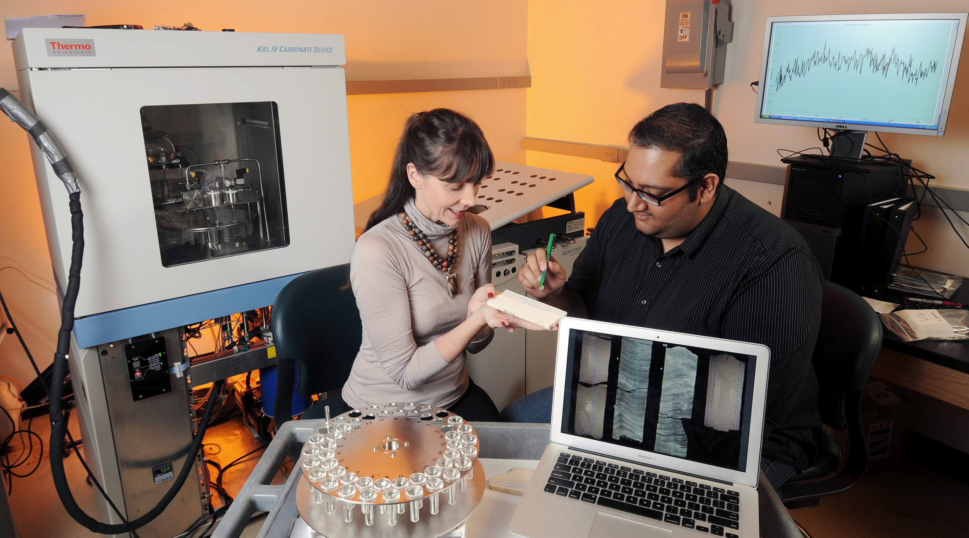

Slide 19
CORROBORATING THE CORAL STORY
coral geochemistry
temperature

Slide 20
AFTER 15 YEARS OF WORK

Slide 21
TROPICAL PACIFIC CLIMATE
OVER THE LAST MILLENNIUM
warm
cool
20th century trend towards warmer conditions is unprecedented.

Slide 22
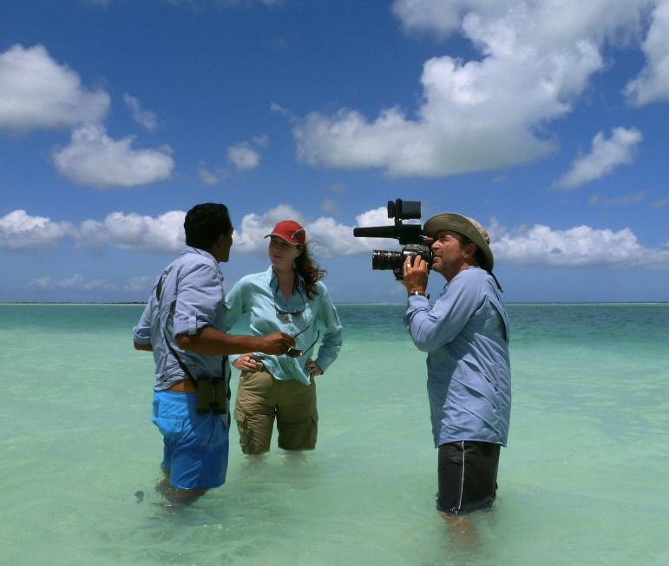
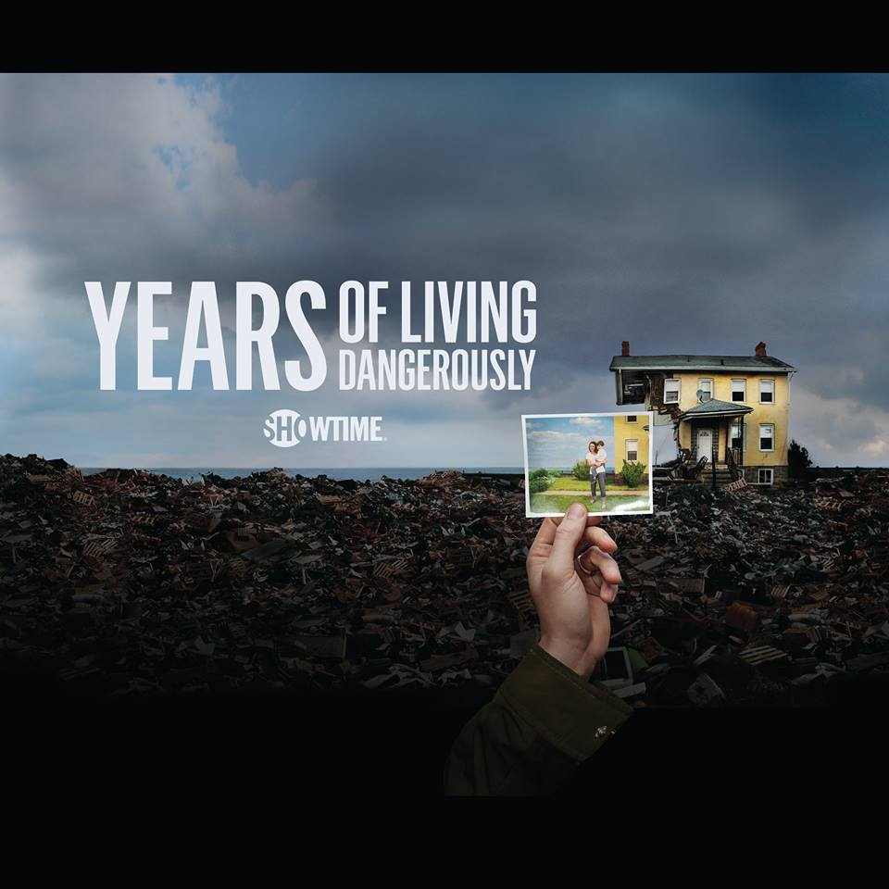
EPISODE 3:
THE SURGE

Slide 23
Work with
PASSION

Slide 24
Work with
PURPOSE

Slide 25
The rocks have spoken.
THANK YOU FOR LISTENING
@coralsncaves

Slide 26
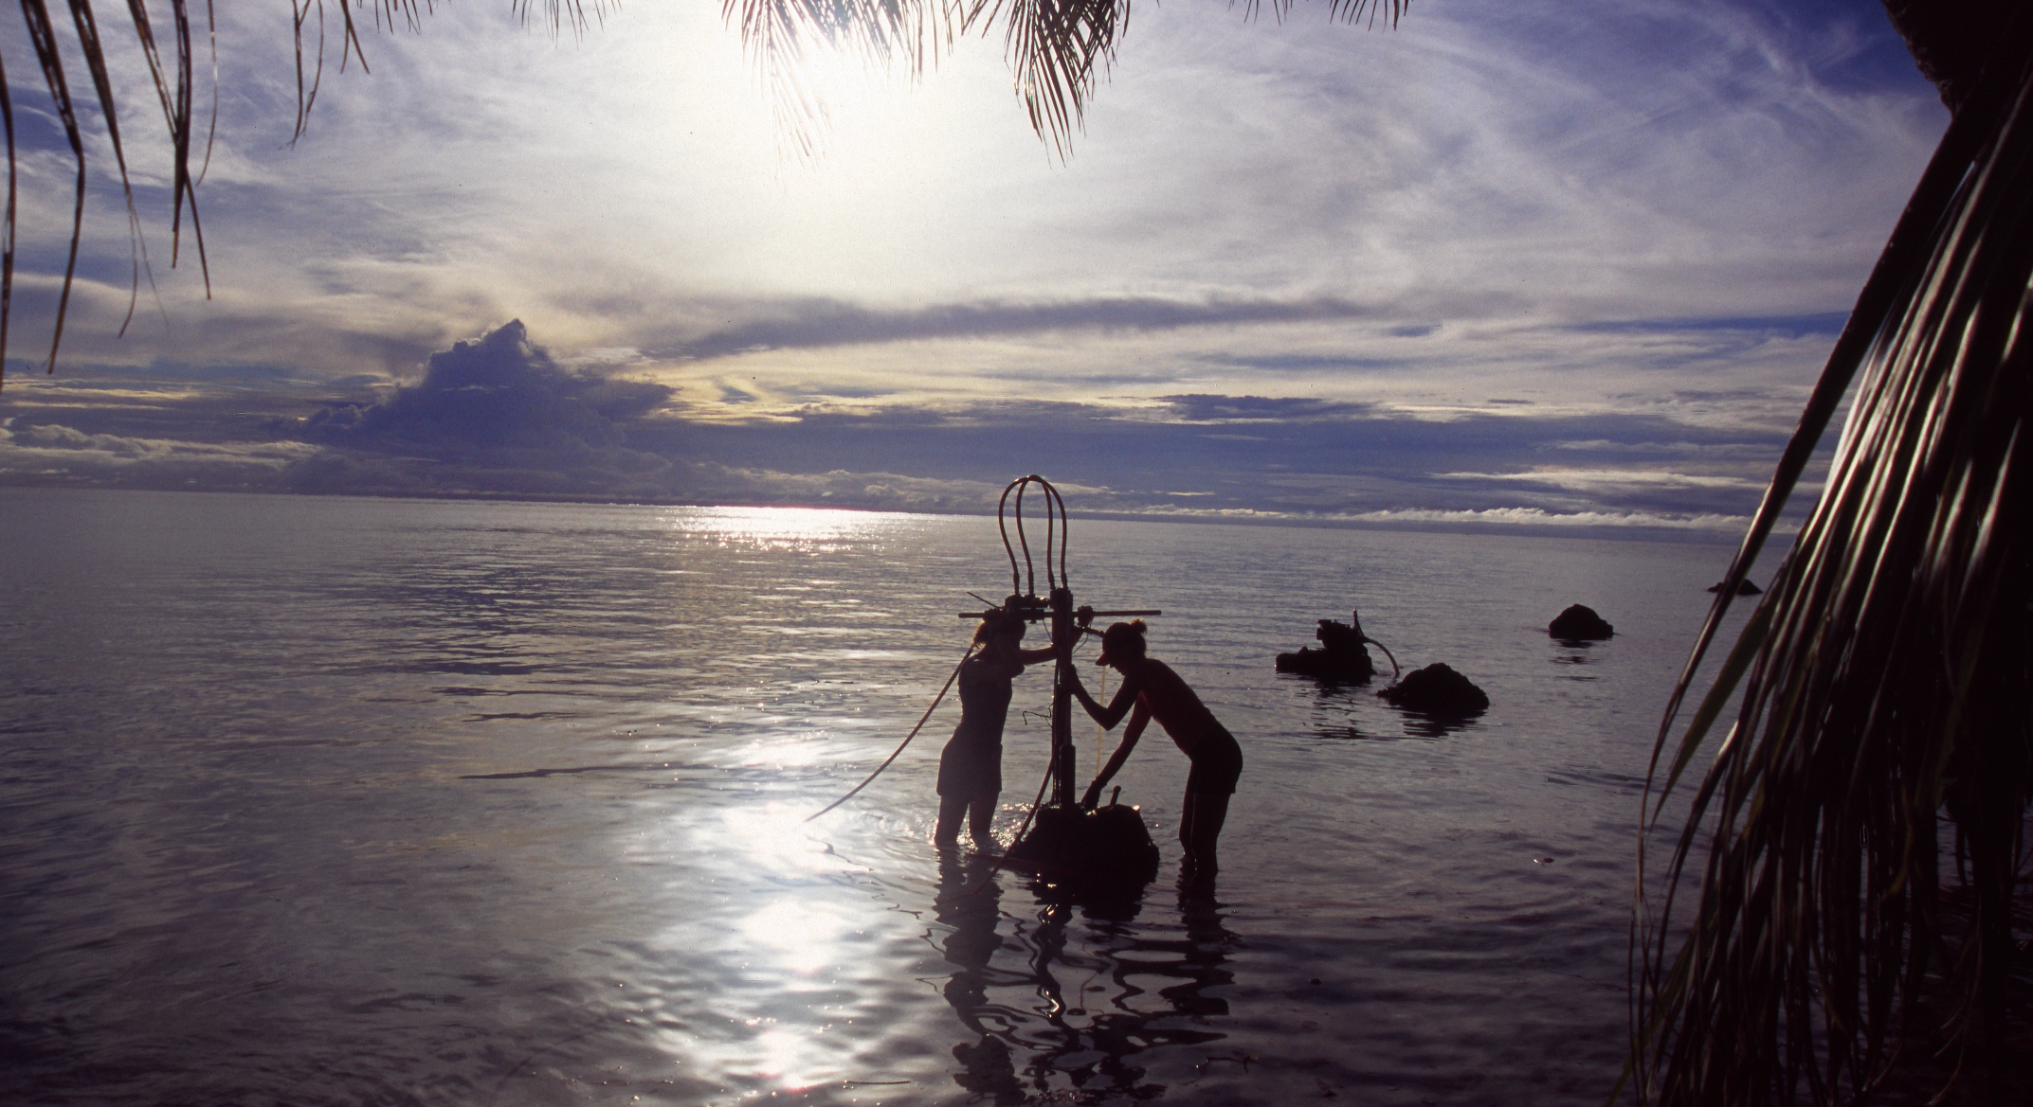
The rocks have spoken.
THANK YOU FOR LISTENING
@coralsncaves

