Slide 1
Team CRC goal: 10,000 lbs CO2 averted/offset
Some important #’s for designing CRC plans:
lbs of CO2 generated from 1kwhr of electricity in the SE: 2.2
lbs of CO2 generated by average American in 1 yr: 25,000 lbs
lbs of CO2 generated from 1 gallon of gasoline: 18

Slide 2
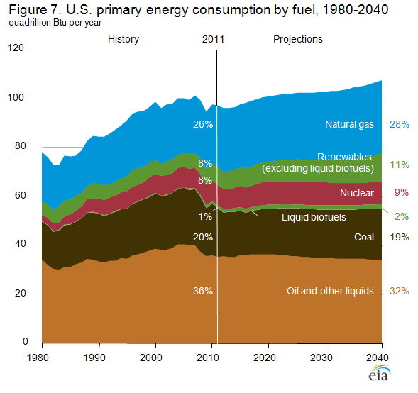

Slide 9
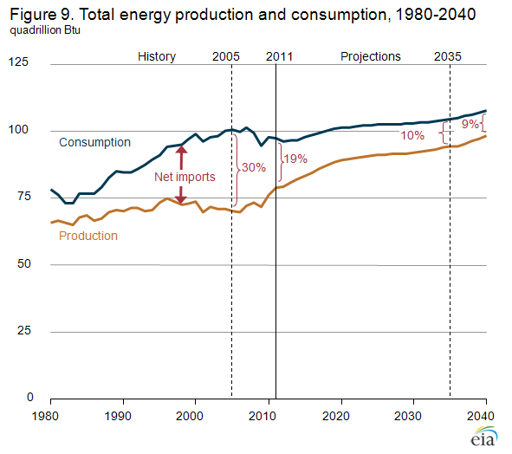

Slide 10
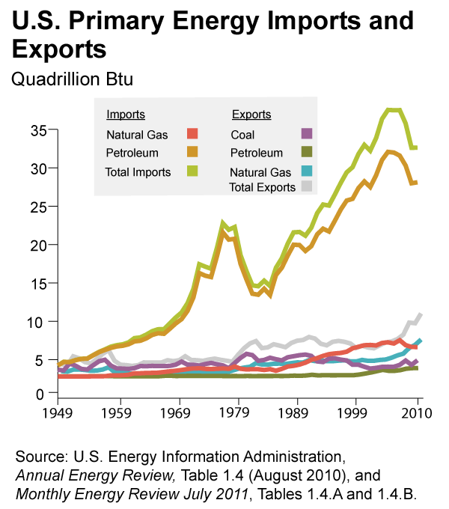

Slide 13
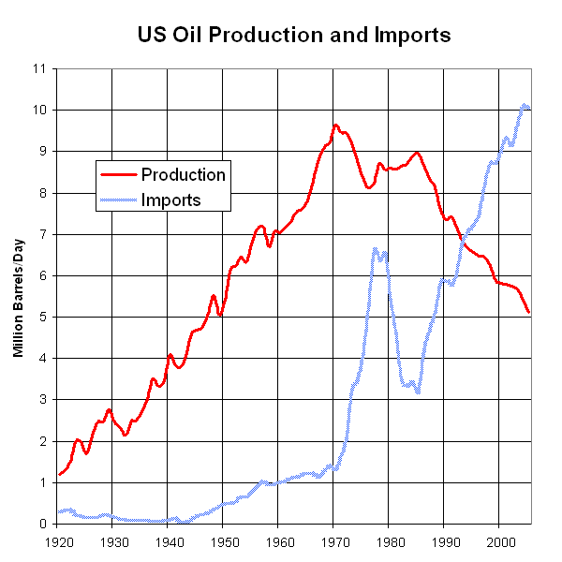
US Oil Production is in decline; rest of the world to follow, but WHEN?

Slide 14
Domestic Oil Production is UP! → deepwater drilling

Slide 15
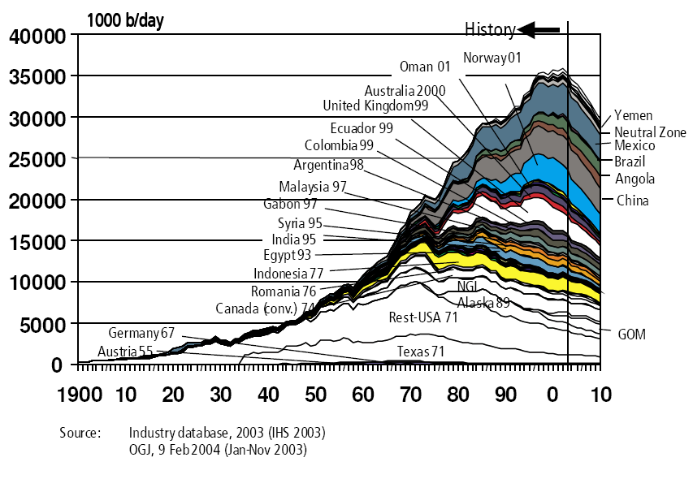
Peak Oil: not “if”, but “when”

Slide 16
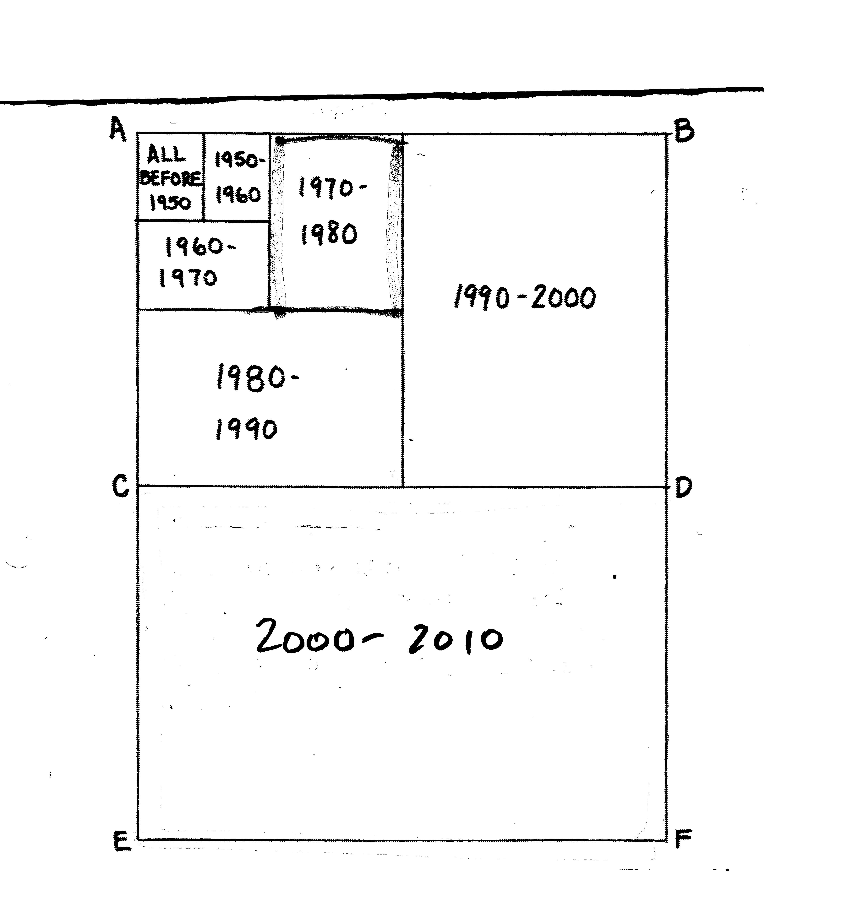
Oil used since 1950 (R=7)
Recall
T₂=70/R
2010 - 2020 ?

Slide 17
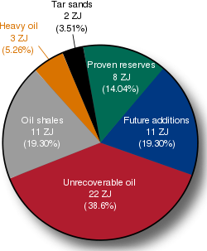
Global oil consumption = 0.18 ZJ/yr;
1ZJ = 10²⁰ J

Slide 18
www.giss.nasa.gov/research/briefs/kharecha_01/Fig1.pdf

Slide 19
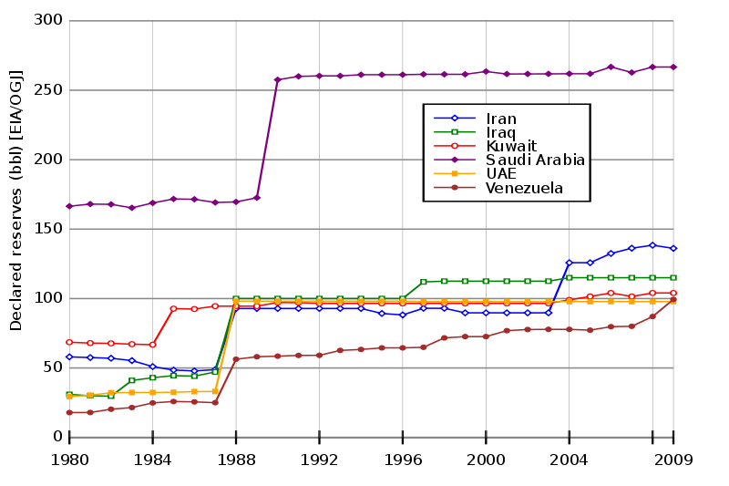
Quantifying OPEC oil reserves is a shell game! Nobody knows….

Slide 20
bp.com

Slide 21
COAL: a whole different ballgame of “have’s” and “have-not’s”
bp.com

