Slide 1
Basics of electricity
Current (I, measured in amperes) flows from – to +
Voltage (V, measured in volts) reflects the potential difference
between a negatively and positively charged material
Resistance (R, measured in ohms) prevents flow of electrons;
depends on material, distance, and temperature
Ohm’s Law: V=R * I
Ex: US uses 120V; toaster is 15ohms, so I=120/15 = 8 amps
of current going through toaster
Power = V * I
Voltage fixed at 120V; so toaster has power of 120*8 = 960Watts (joules/s)
Energy = P * time (this is what you pay for)
Leave toaster on for 30min, then E = 960Watts * 0.5hr = 0.480 kilowatt hours

Slide 2
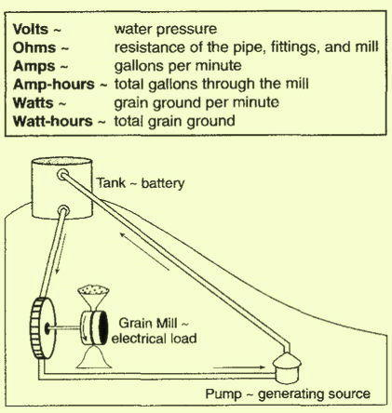
A clever analogy
voltage
resistance
current

Slide 3
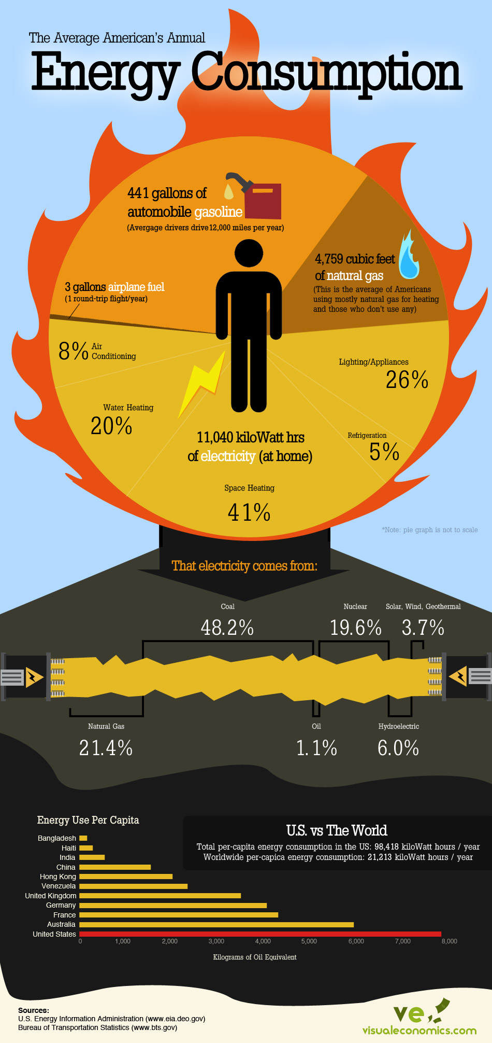

Slide 5
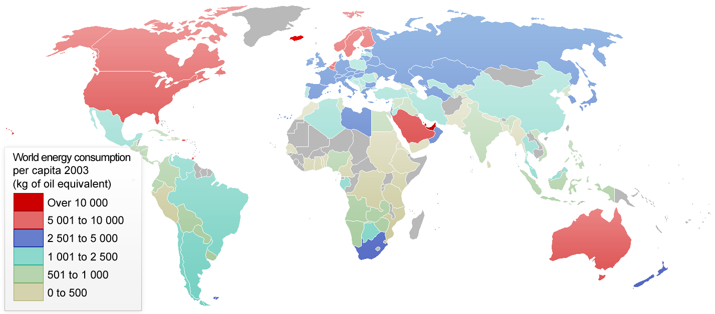
World energy consumption per capita 2003

Slide 6

Map of relative ecological footprints
http://www.worldmapper.org/display.php?selected=322

Slide 7
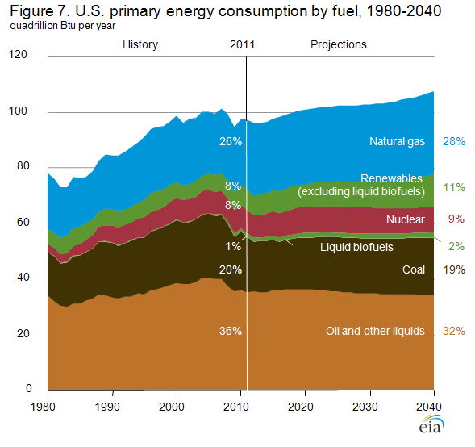

Slide 10
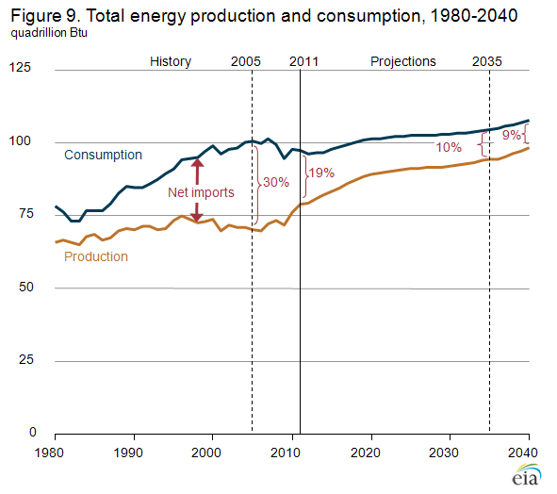

Slide 15
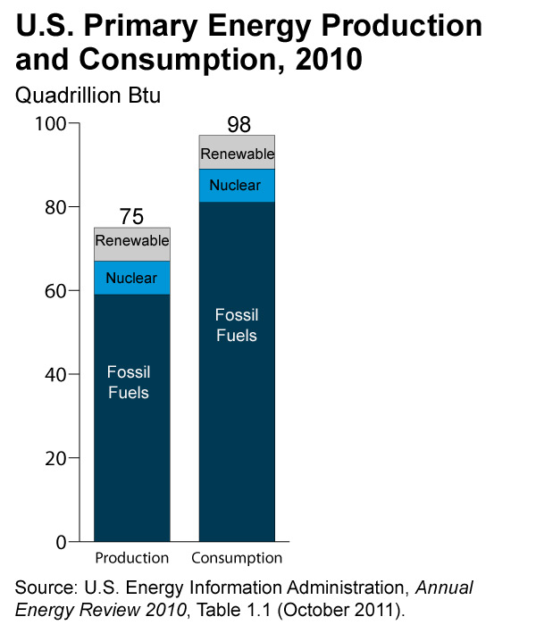

Slide 16


Slide 19
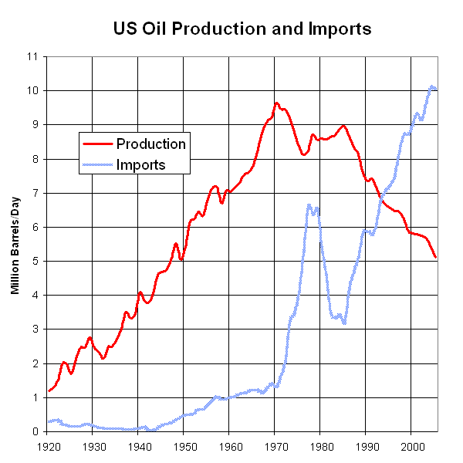
US Oil Production is in decline; rest of the world to follow, but WHEN?

Slide 20
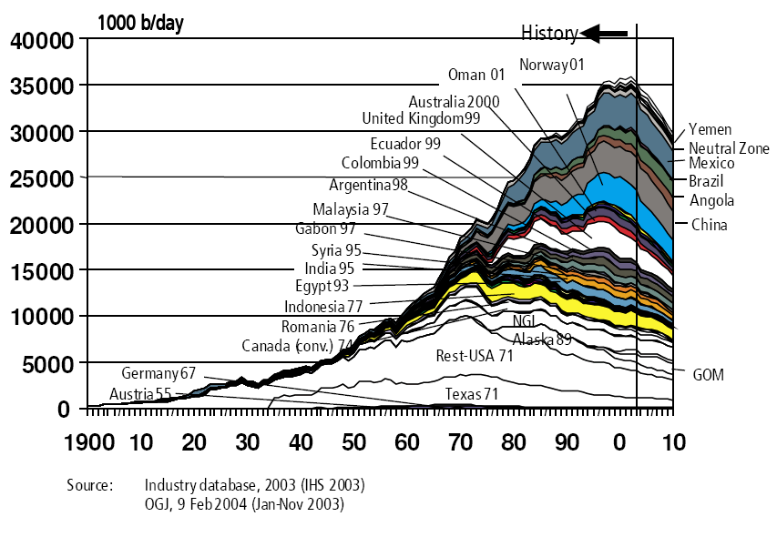
Peak Oil: not “if”, but “when”

Slide 21
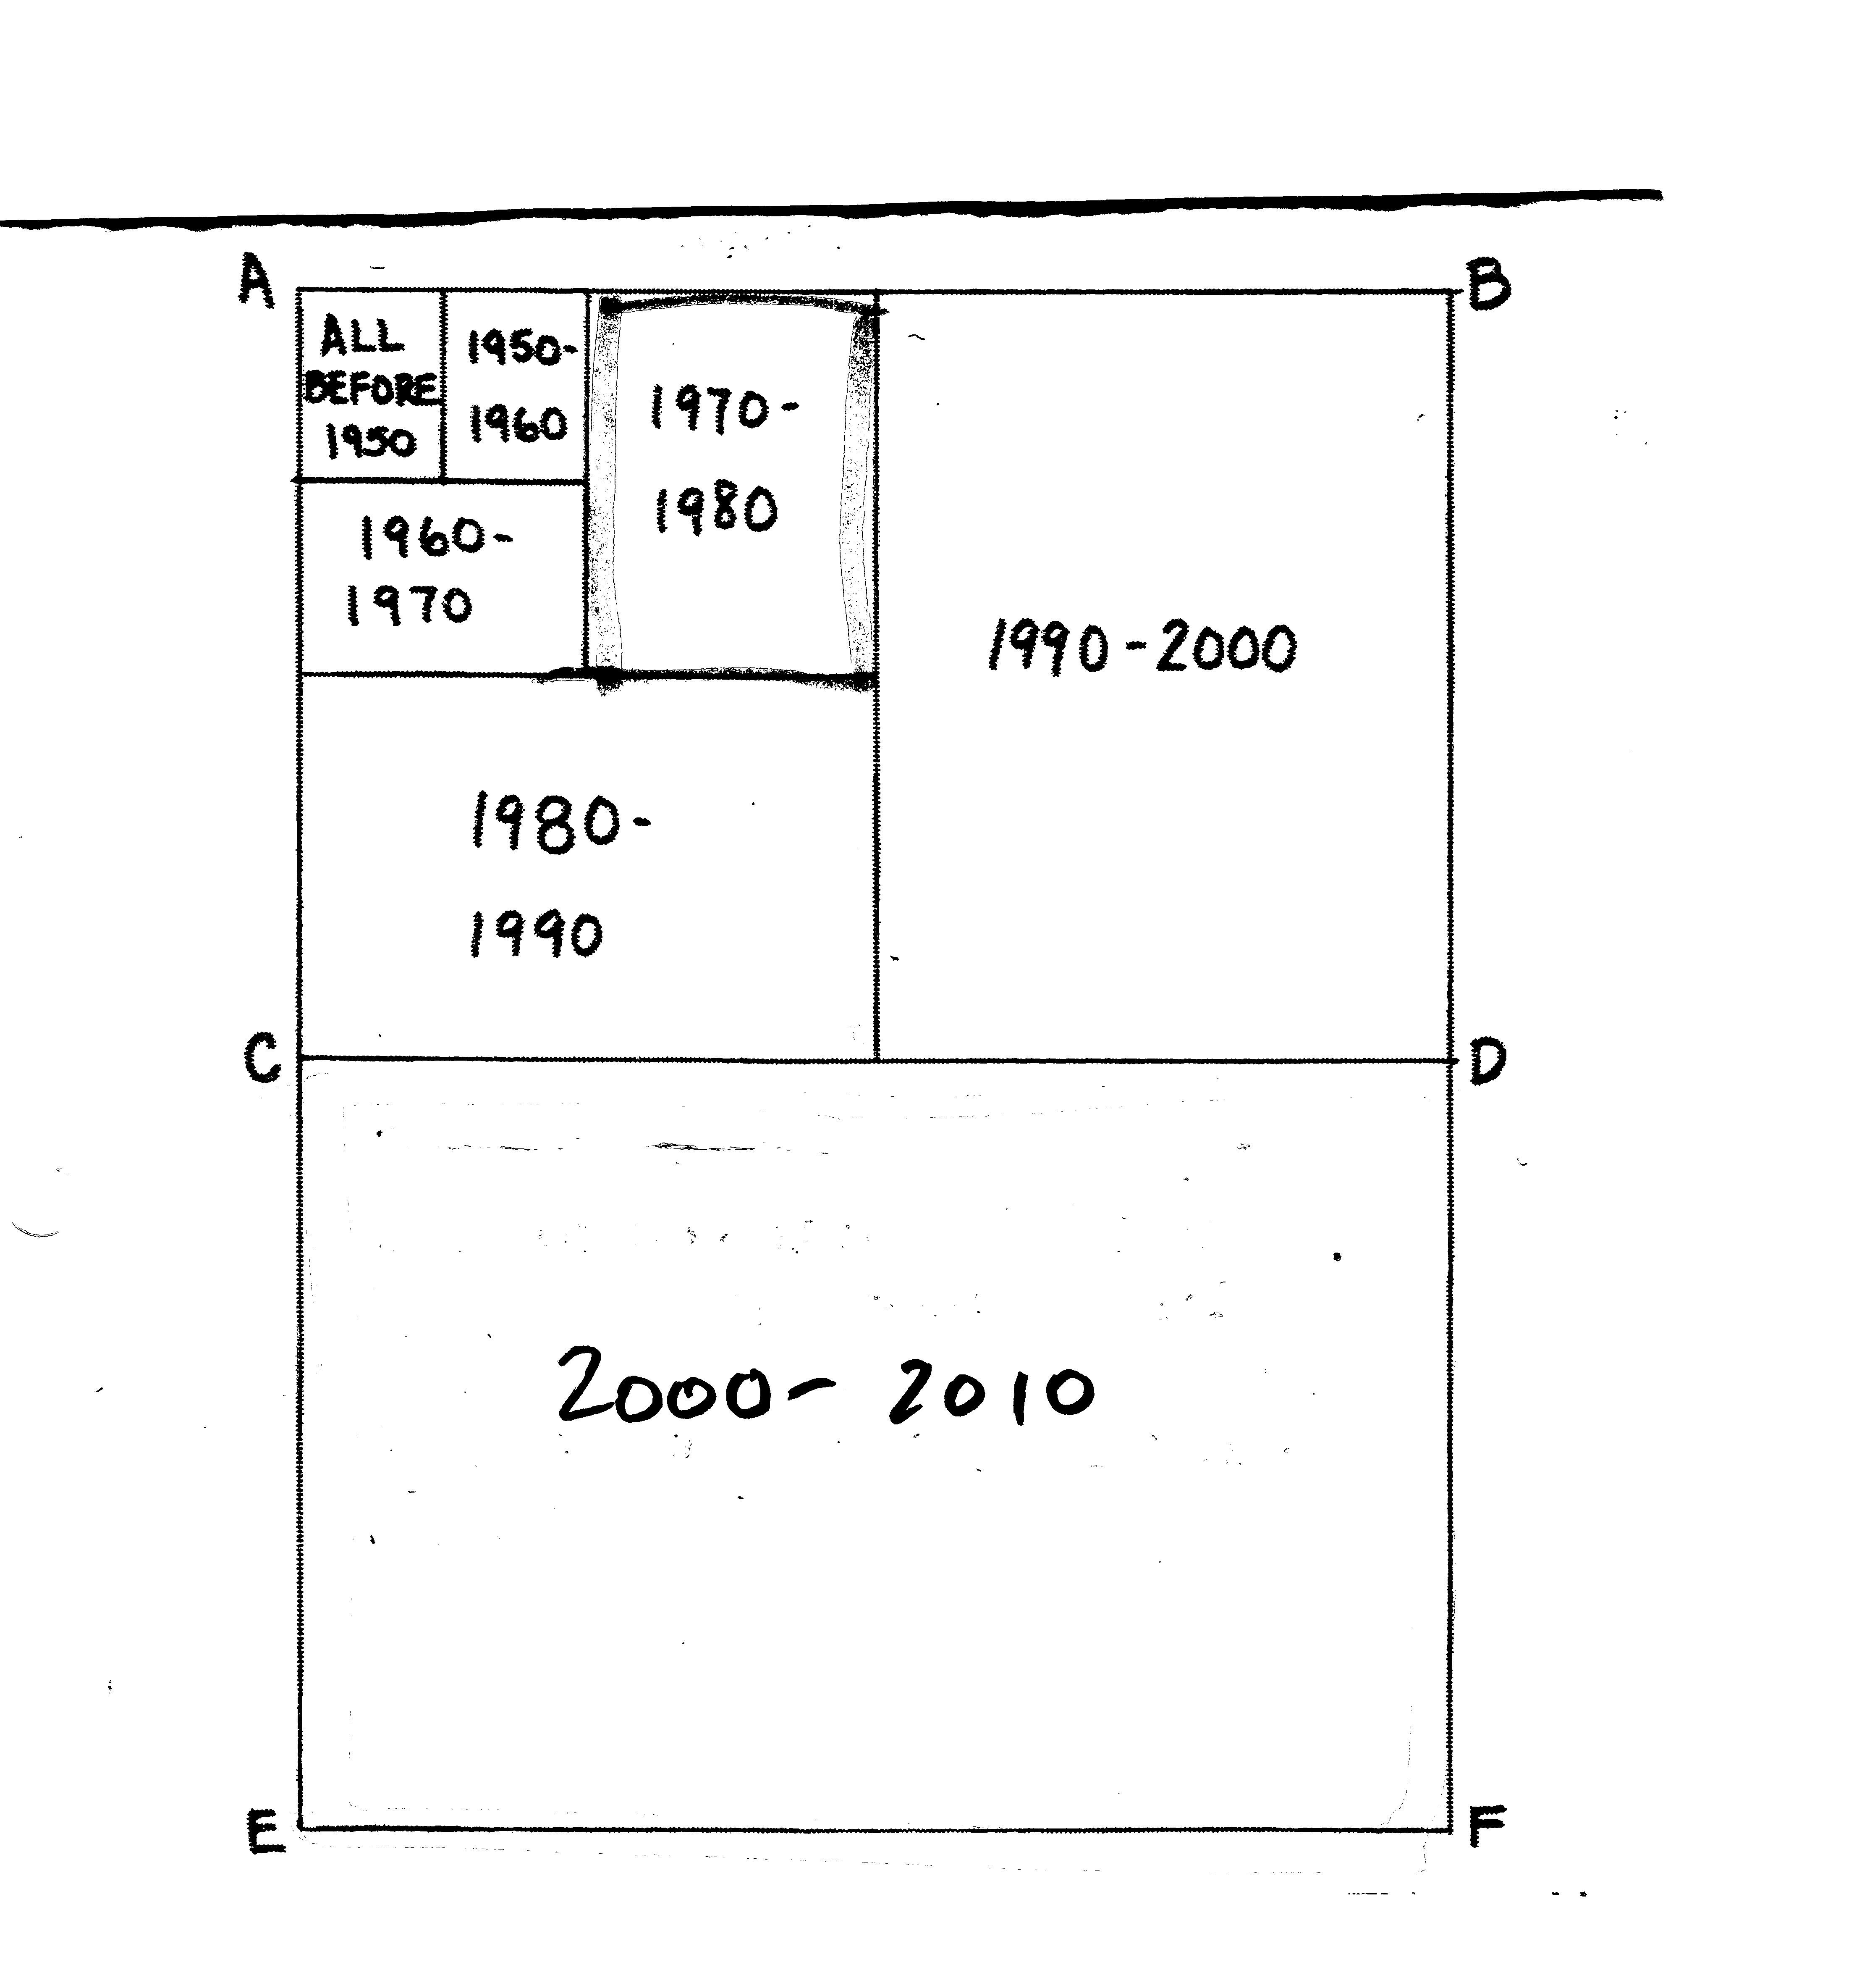
Oil used since 1950 (R=7)
Recall
T₂=70/R
2010 - 2020 ?

Slide 22
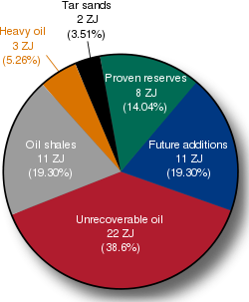
Global oil consumption = 0.18 ZJ/yr;
so ~80 yrs supply of reserves
1ZJ = 10²⁰ J

Slide 23
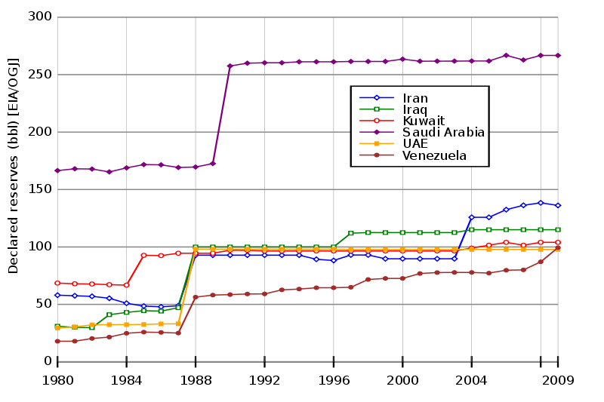
Quantifying OPEC oil reserves is a shell game! Nobody knows….

Slide 24
bp.com

Slide 25
COAL: a whole different ballgame of “have’s” and “have-not’s”
bp.com

