Slide 1
Intergovernmental Panel of Climate Change

Slide 2
Intergovernmental Panel of Climate Change
formed in 1988 by World Meteorological Organization and the
United National Environmental Program
IPCC’s job:
“...to assess on a comprehensive, objective, open and transparent
basis the scientific, technical and socio-economic information relevant
to understanding the scientific basis of risk of human-induced climate
change, its potential impacts and options for adaptation and mitigation.
IPCC reports should be neutral with respect to policy, although they
may need to deal objectively with scientific, technical and socio-
economic factors relevant to the application of particular policies.”
Assessment reports in:
1990, 1995, 2001, 2007, and 2013

Slide 4
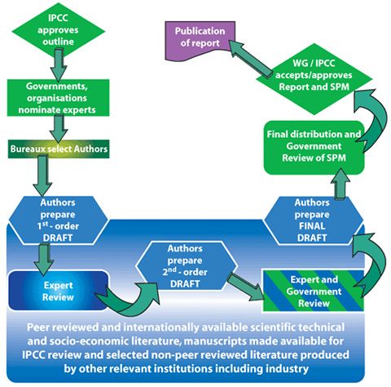
831 lead
authors
10,000+
comments

Slide 5
IPCC pros?
IPCC cons?

