Slide 1
Team CRC goal: 20,000 lbs CO2 averted/offset
Some important #’s for designing CRC plans:
lbs of CO2 generated from 1kwhr of electricity in the SE: 2.2
lbs of CO2 generated by average American in 1 yr: 25,000 lbs
lbs of CO2 generated from 1 gallon of gasoline: 18

Slide 2
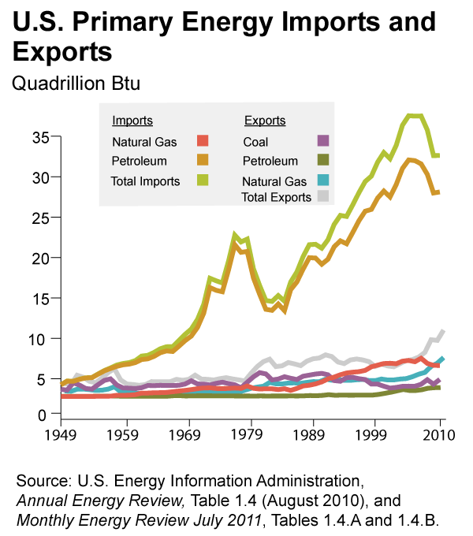

Slide 4
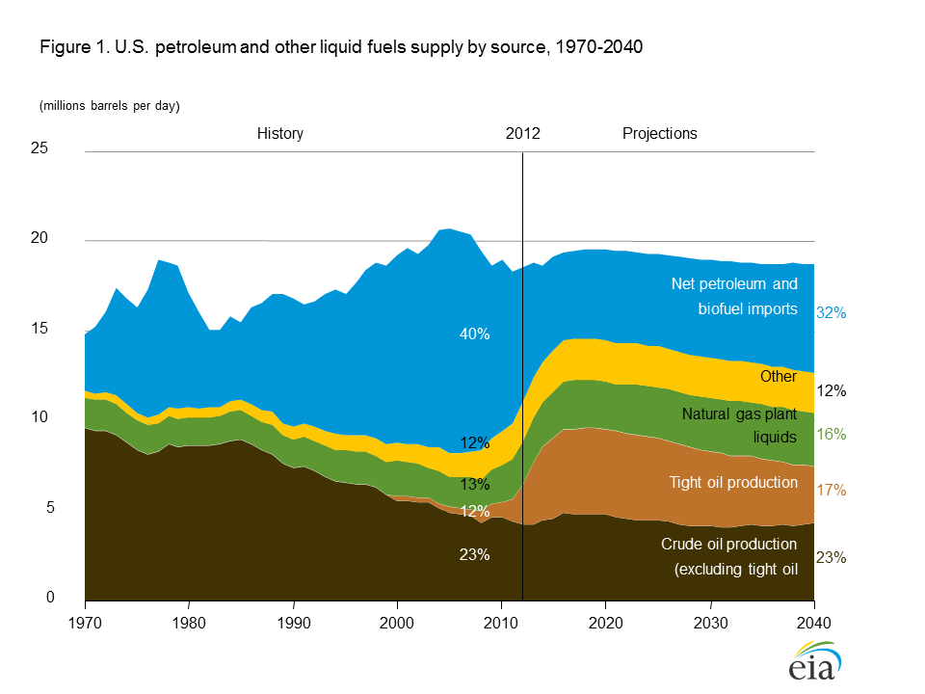
Growing domestic production of natural gas and crude oil continues to reshape
the U.S. energy economy, with crude oil production approaching the historical
high achieved in 1970 of 9.6 million barrels per day

Slide 5
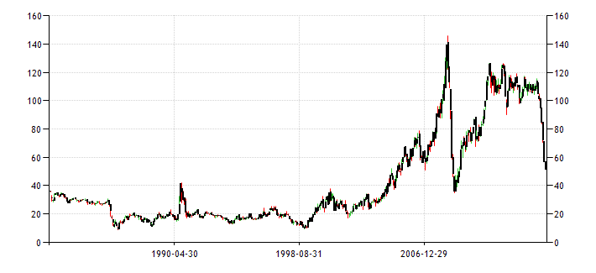
A new era of cheap oil: here to stay?
Dollars per barrel, Jan 1982-Jan 2015
http://www.tradingeconomics.com/commodity/brent-crude-oil

Slide 6
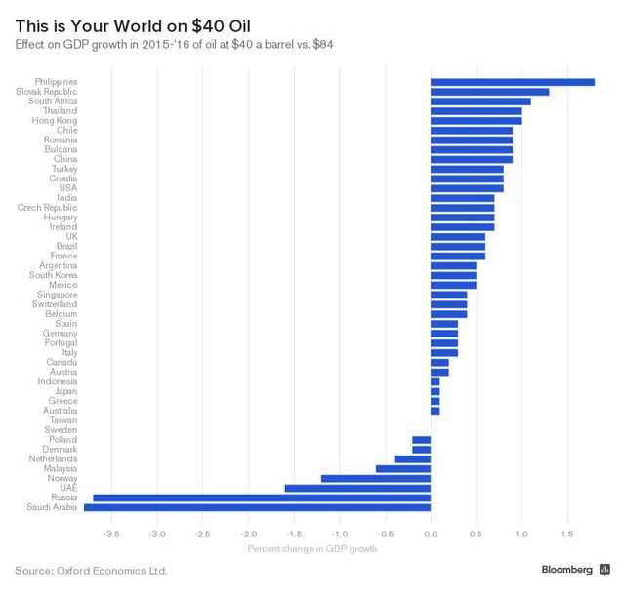

Slide 8
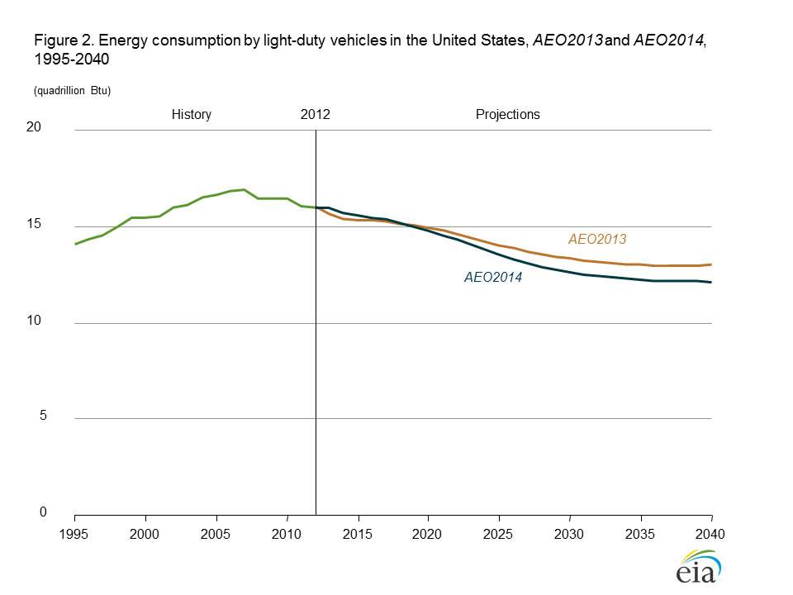
Light-duty vehicle energy use declines sharply, reflecting slow growth in vehicle miles
traveled and accelerated improvement in vehicle efficiency

Slide 9
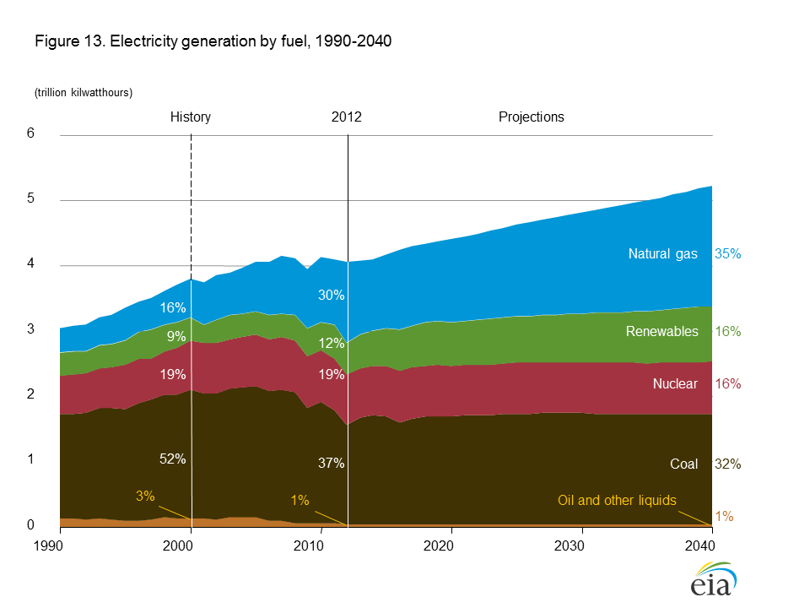

Slide 10
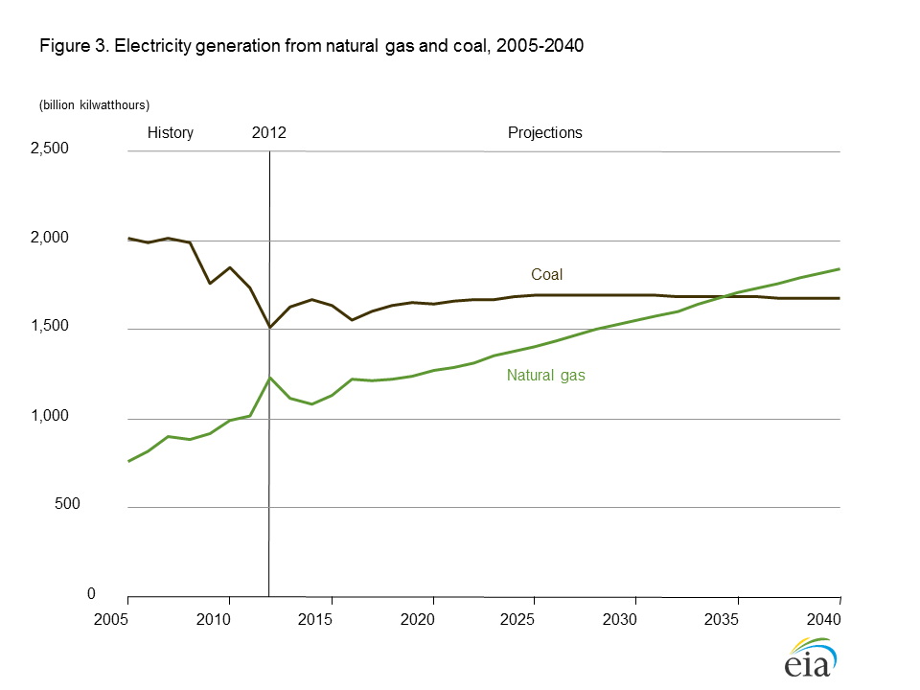

Slide 11
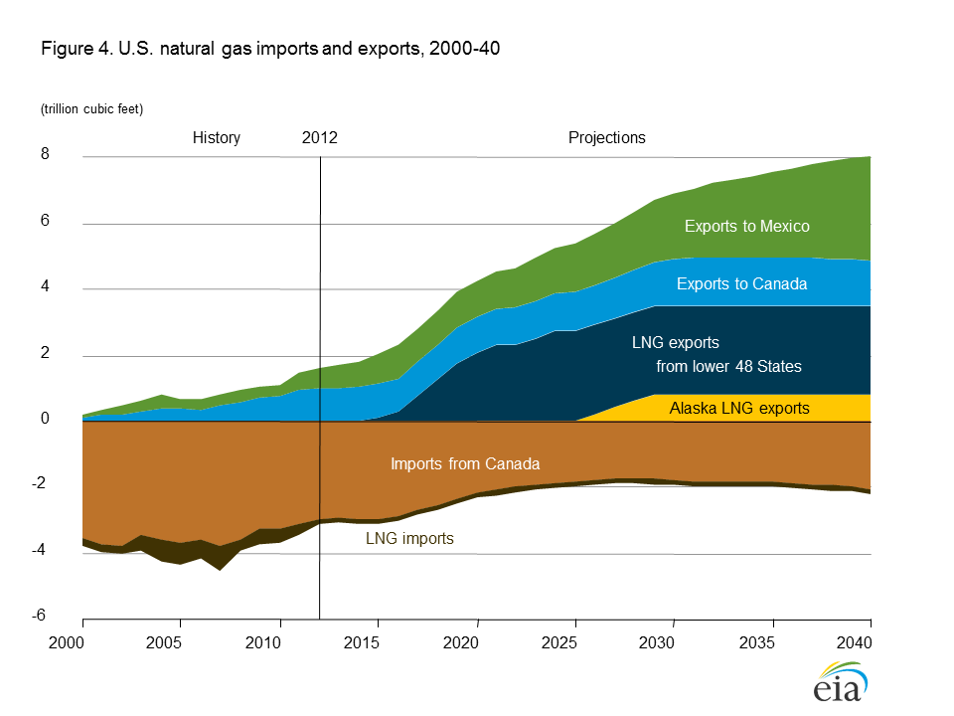

Slide 16
Coal supply regions

Slide 17
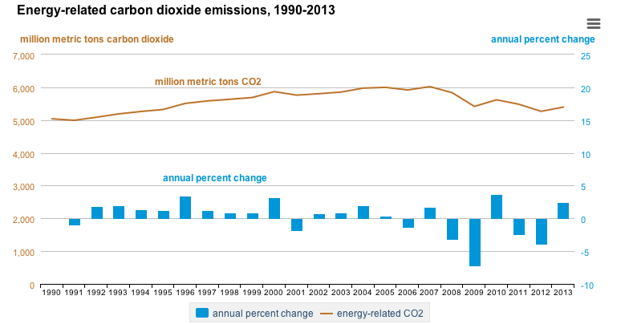

Slide 18
www.giss.nasa.gov/research/briefs/kharecha_01/Fig1.pdf

Slide 19
COAL: a whole different ballgame of “have’s” and “have-not’s”
bp.com

