Slide 1

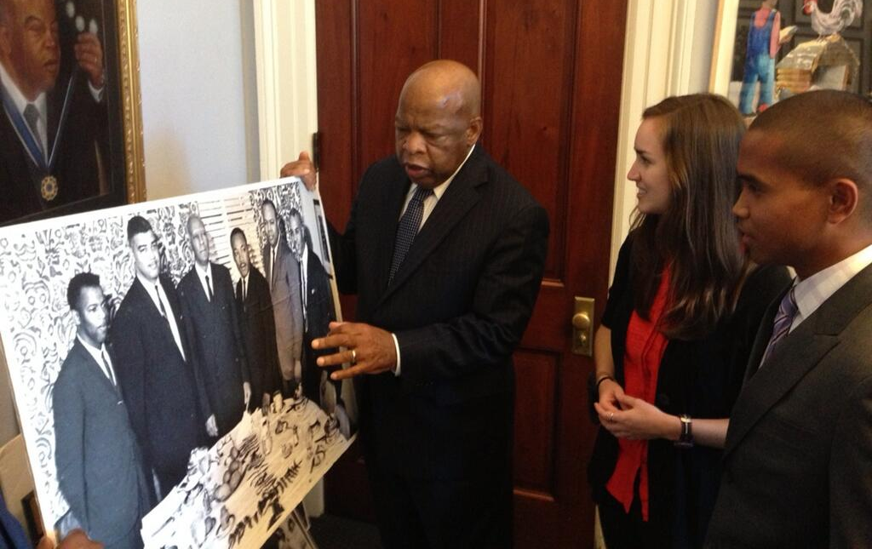

Energy on the Hill Internship
What it is: an internship program funding GT students to engage with energy-related policy development on Capitol Hill for a semester
Who can apply: anyone with an interest in energy
(supply, technology, economics, security, or policy)
Pay: $7,500 for spring/fall; $5,000 for summer
Benefits to Student:
enrich education with hands-on experience
build a professional network
acquire unique skills for jobs in industry, governmental, or nonprofit sectors
live and work in beautiful Washington DC
Apply: http://shadow.eas.gatech.edu/~kcobb/energy_app.docx
Deadline: January 15 for Summer 2015

Slide 2
Basics of electricity
Current (I, measured in amperes) flows from – to +
Voltage (V, measured in volts) reflects the potential difference
between a negatively and positively charged material
Resistance (R, measured in ohms) prevents flow of electrons;
depends on material, distance, and temperature
Ohm’s Law: V=R * I
Ex: US uses 120V; toaster is 15ohms, so I=120/15 = 8 amps
of current going through toaster
Power = V * I
Voltage fixed at 120V; so toaster has power of 120*8 = 960Watts (joules/s)
Energy = P * time (this is what you pay for)
Leave toaster on for 30min, then E = 960Watts * 0.5hr = 0.480 kilowatt hours

Slide 3
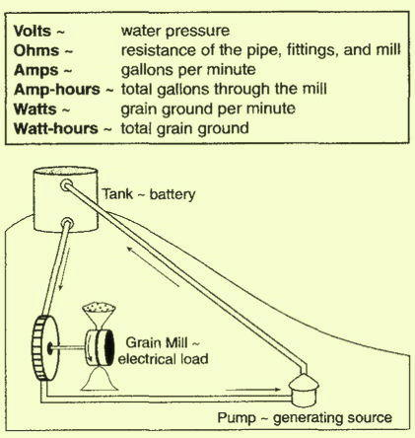
A clever analogy
voltage
resistance
current

Slide 4
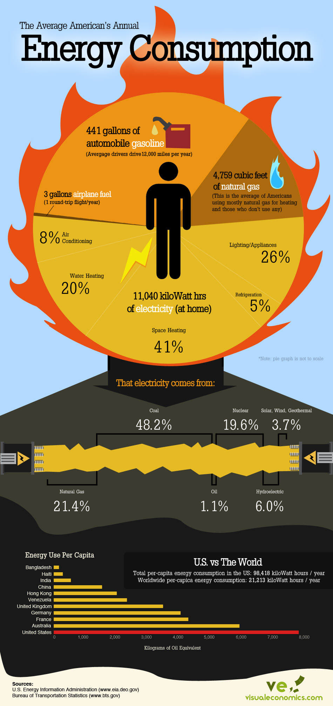

Slide 5
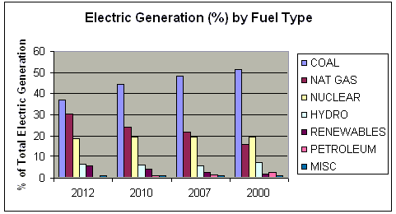
What trends do you see in this graph?

Slide 6
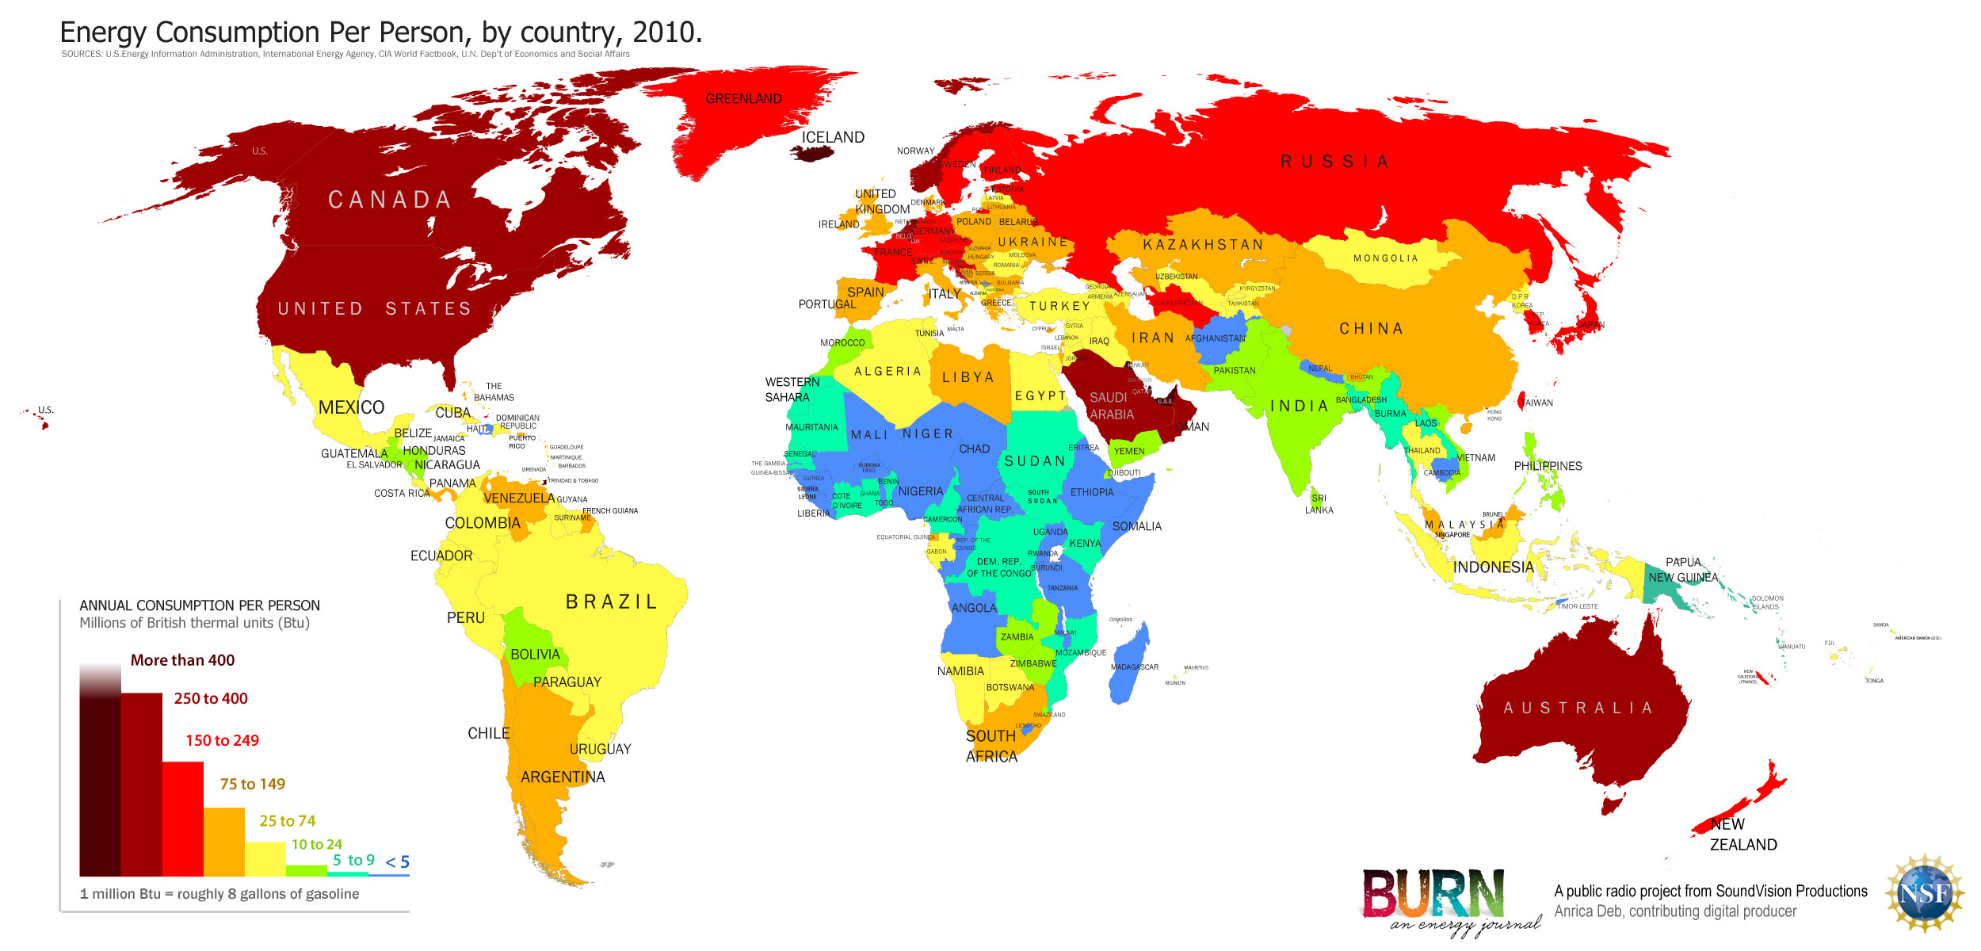
World energy consumption per capita 20010

Slide 7
Graphic by The Guardian, Data from EIA

Slide 8
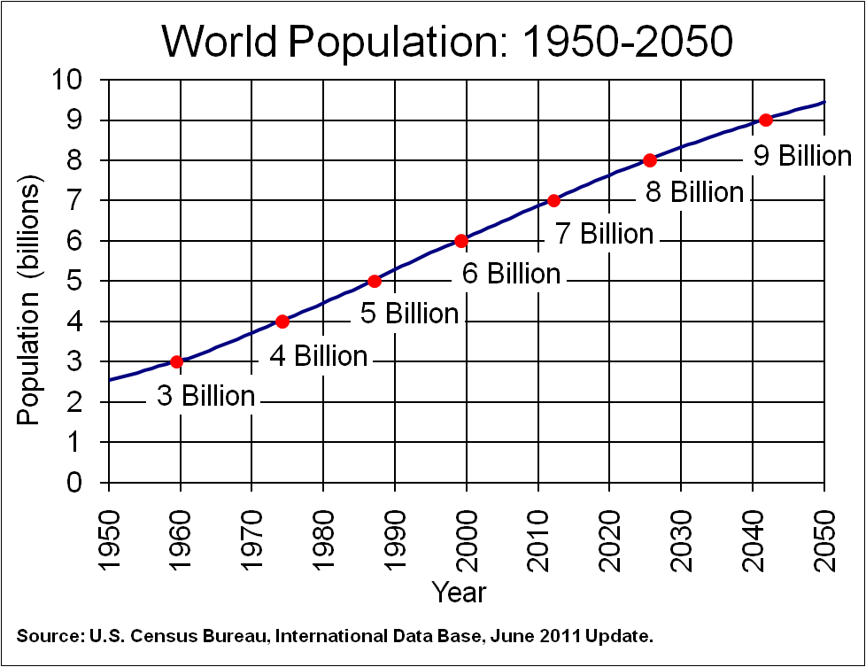

Slide 9
The Energy “Haves” and “Have Nots”

Slide 11
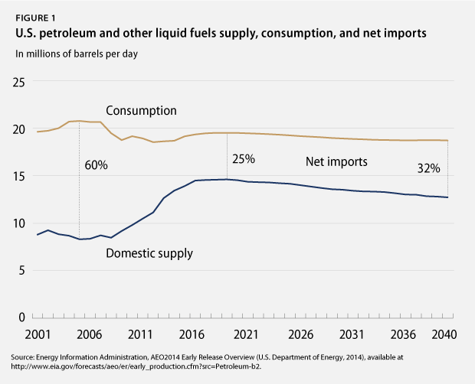

Slide 12
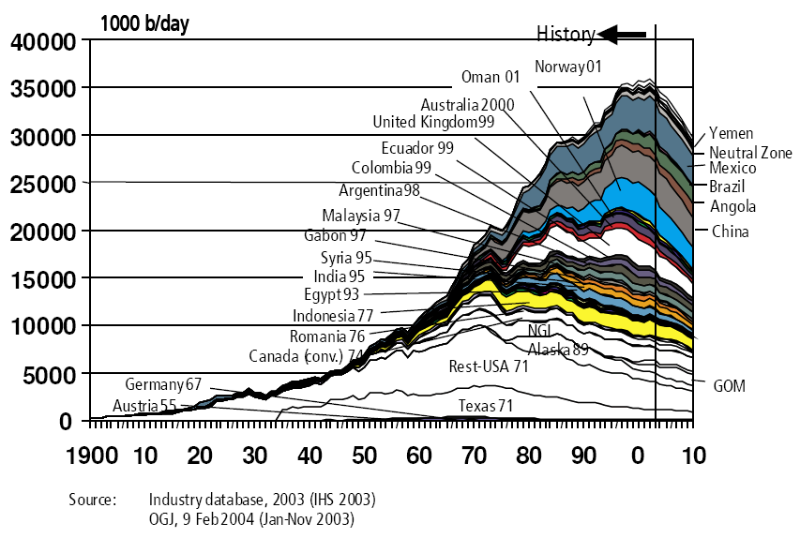
Peak Oil: not “if”, but “when”

Slide 13
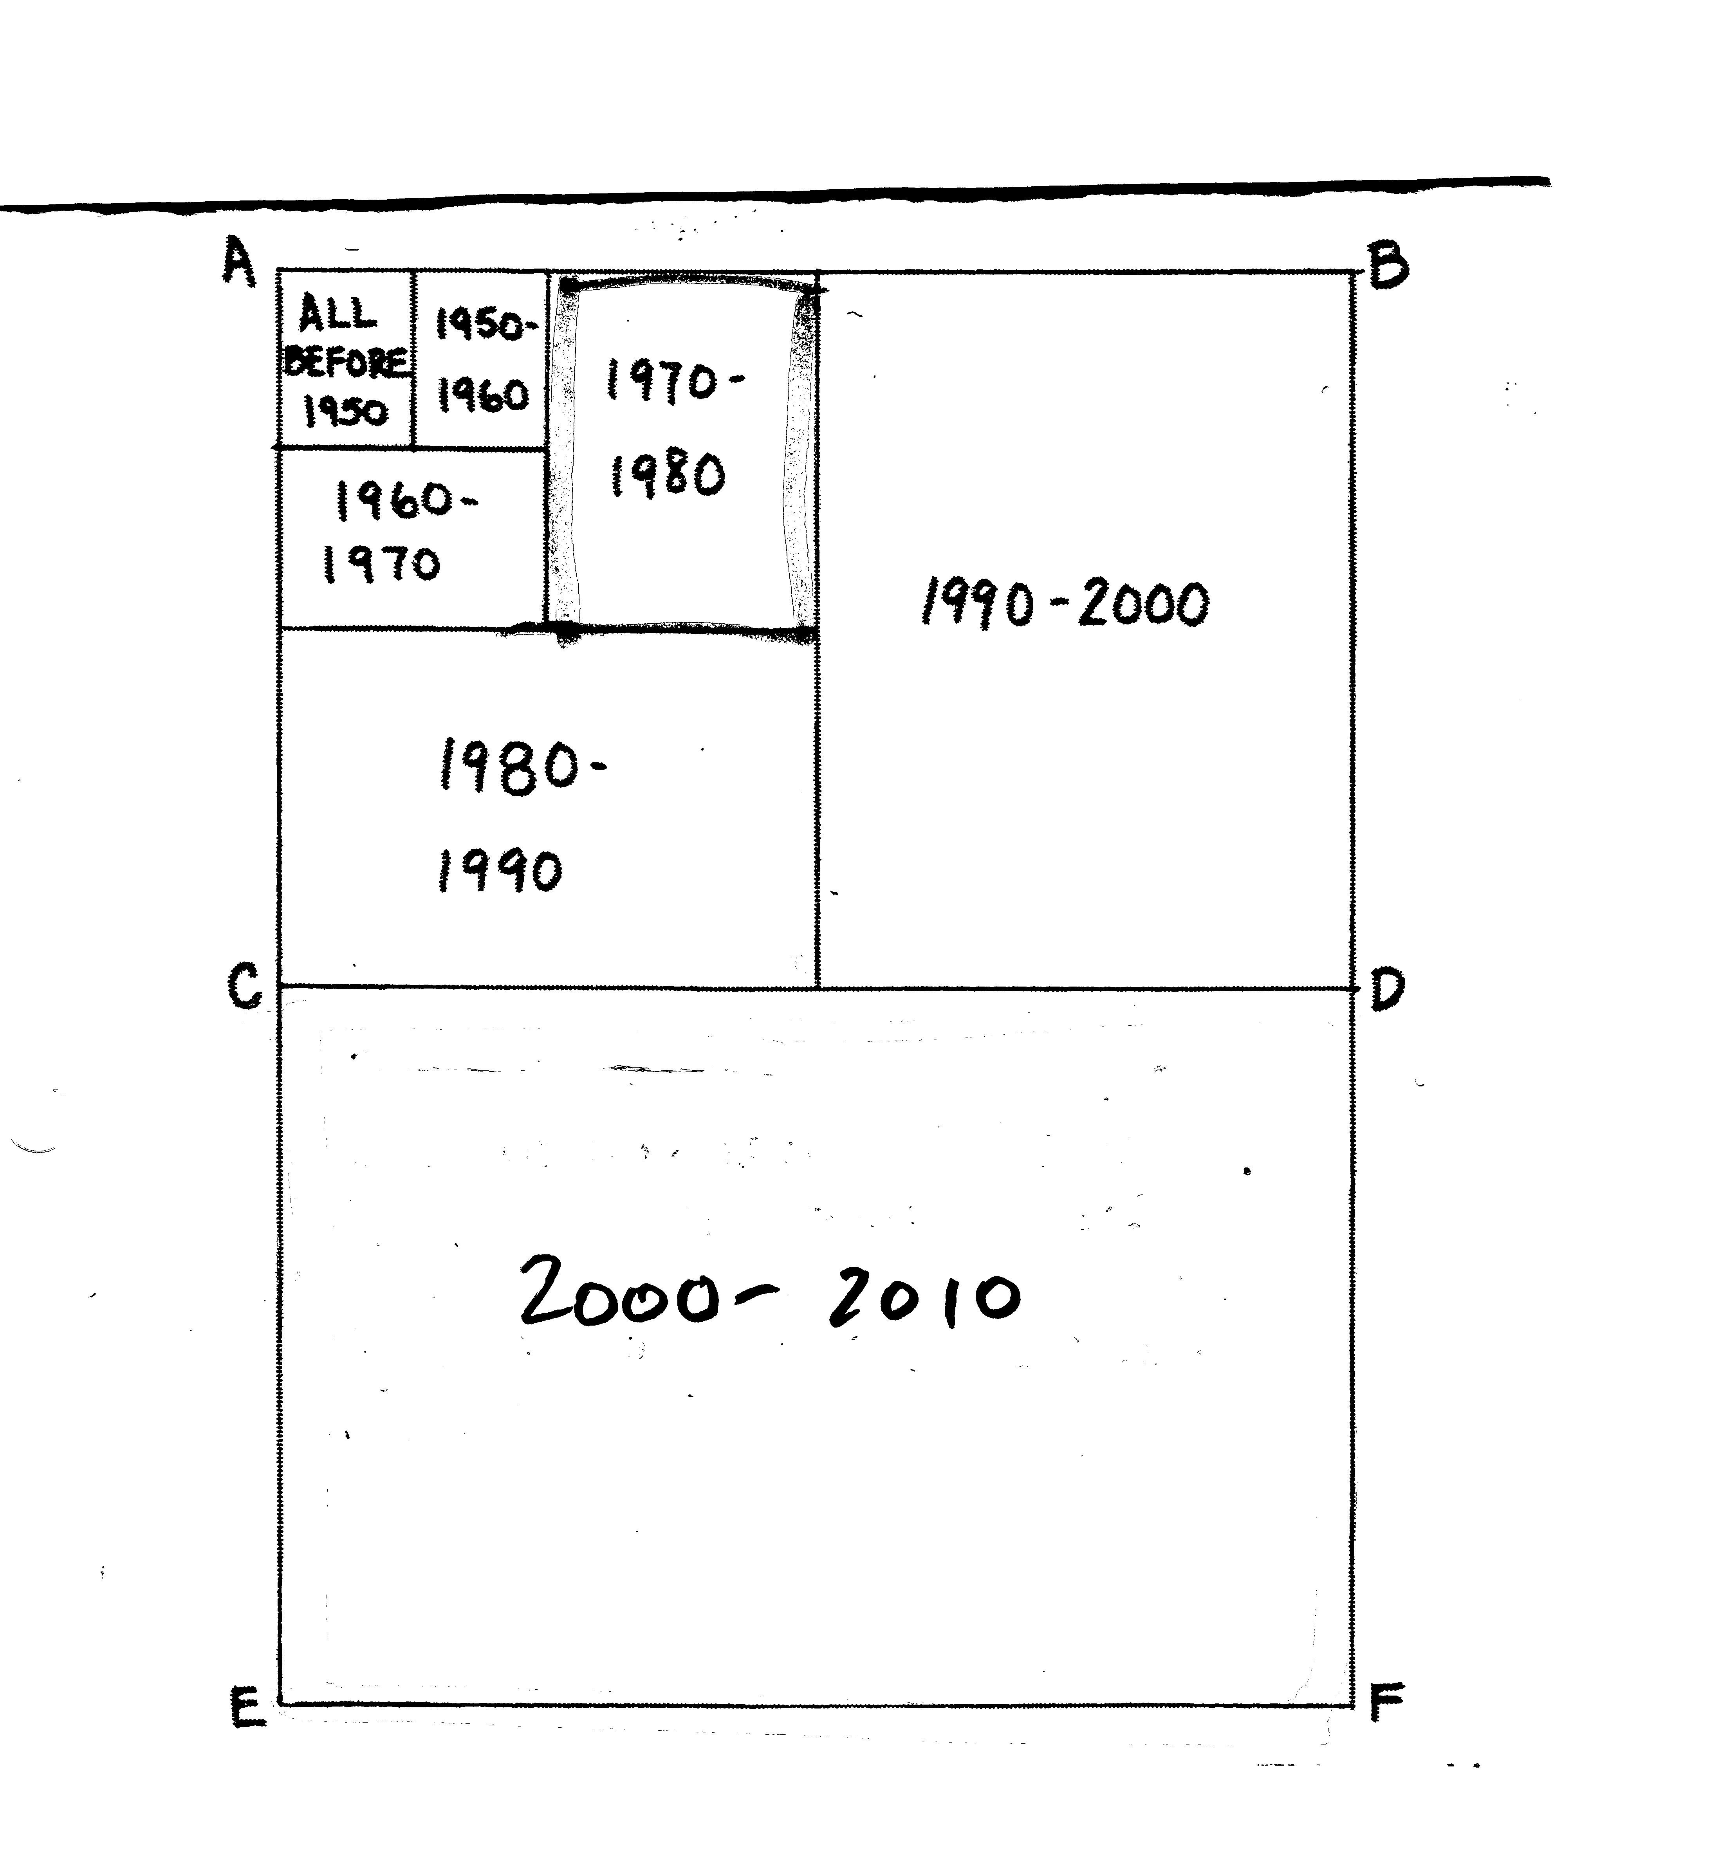
Oil used since 1950 (R=7)
Recall
T₂=70/R
2010 - 2020 ?

Slide 14
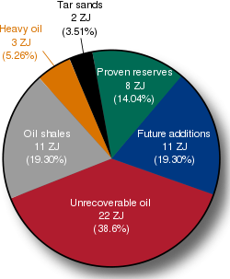
Global oil consumption = 0.18 ZJ/yr;
so ~80 yrs supply of reserves
1ZJ = 10²⁰ J

Slide 15
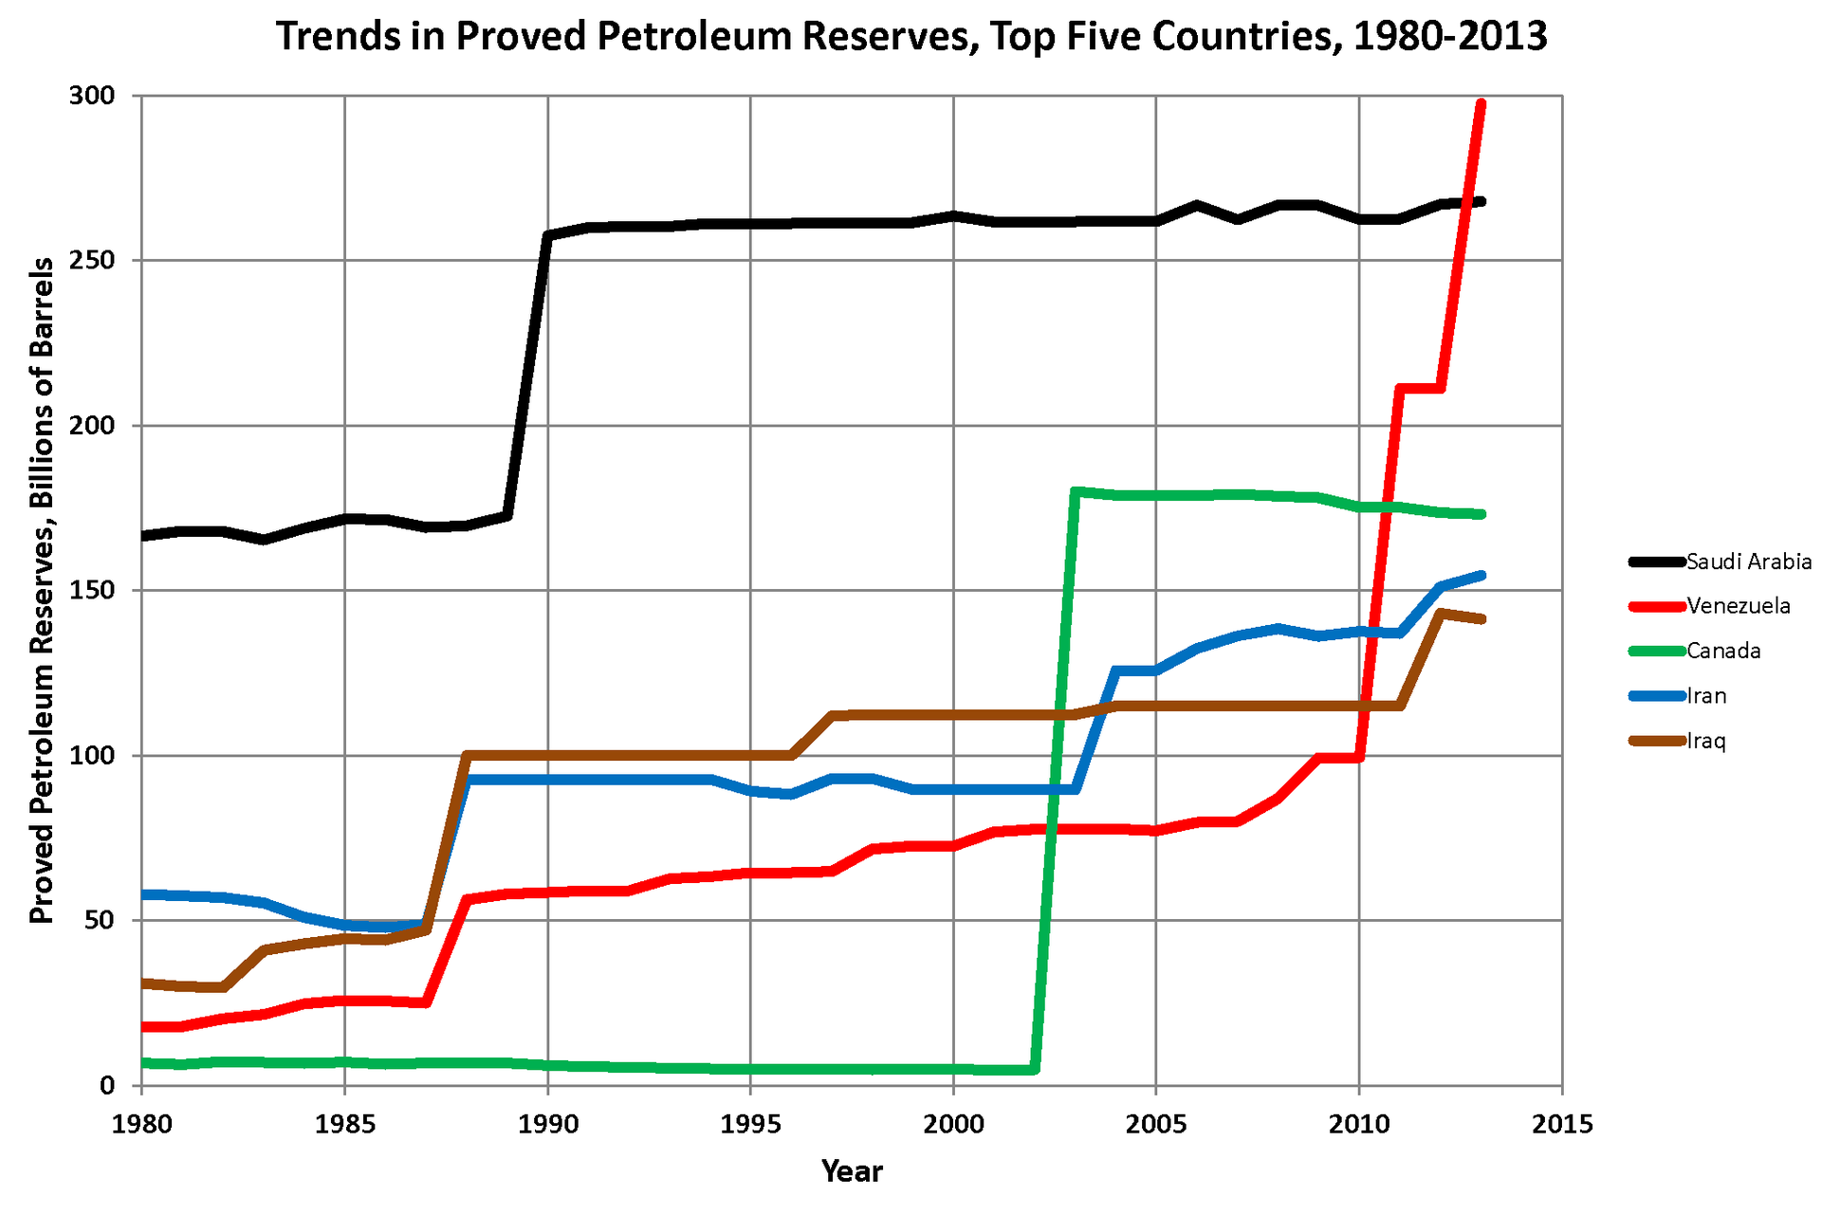
Quantifying OPEC oil reserves is a shell game! Nobody knows….

Slide 16
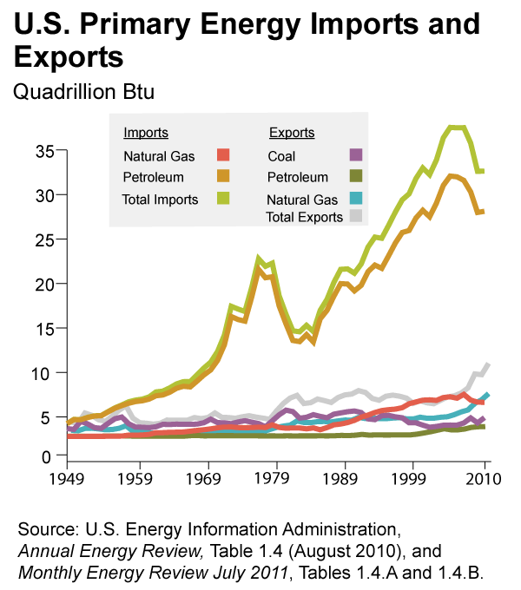

Slide 17
